Slide 1
Knime: a data mining platform
Department of Computer Science
School of Electrical Engineering
University of Belgrade

Slide 2
The problems we consider
Ability to access various data sources
Data preprocessing capability
Integration of different techniques
Ability to operate on large datasets: scalability
Good data and model visualization
Extensibility
Interoperability with other systems
Active development community
Cost
Notes:
– Ability to access various data sources. Data come from databases, data warehouses, and flat files in different formats. A good system will easily access different data sources.
– Data preprocessing capability. Preprocessing occupies a large proportion of the time in a data mining process [19]. Data preparation is often the key to solving the problem. A good system should provide various data
preprocessing functions tasks easily and efficiently.
– Integration of different techniques. There is no single best technique suitable for all data mining problems. A good data mining system will integrate different techniques (preprocessing functions and modelling algorithms),
providing easy access to a wide range of different techniques for different problems.
– Ability to operate on large datasets. Commercial data mining system, such as SAS Enterprise, can operate on very large datasets. This is also
very important for open source data mining systems, so scalability is a key characteristic.
– Good data and model visualization. Experts and novices alike need to investigate the data and understand the models created.
– Extensibility. With new techniques and algorithms it is very important for open source data mining systems to provide an architecture that allows
A Survey of Open Source Data Mining Systems 7 incorporation of new methods with little effort. Good extensibility means easy integration of new methods.
– Interoperability with other systems. Open standards means that systems (whether open or closed source) can interoperate. Interoperability includes
data and model exchange. A good system will provide support of canonical standards, such as CWM [20] and PMML [21].
– Active development community. An active development community will make sure that the system is maintained and updated regularly.
Eficiency – kako raditi DM efikasno
Diversity of implemented algorithms – koje algoritme oruža korisniku
Cost - Koliko to treba platiti
DM in teaching -Kako sprovoditi nastavu
Perspective and stable IDE - Koje je okruženje perspektivno
SW implementations for different platforms
Easy to learn - Koje se brzo uči
Workflow examples - Koje ima primere na internetu
--Koji softver za to koristiti

Slide 3
Importance of data mining
What is data mining?
Data Mining is used for:
competition analysis
market research
economical trends
consume behavior
industry research
“One of the most revolutionary developments”
Notes:
understanding consumer research marketing
product analysis
demand and supply analysis
e-commerce
investment trend in stocks & real estates
telecommunications

Slide 4
The future of data mining
“One of 10 technologies that will change the world”
Factors that affect growth of data mining:
The explosive growth in data collection
The storing of the data in data warehouses
The availability of increased access to data from Web
Wish to increase market share in a globalized economy
Off-the-shelf commercial data mining software
Growth in computing power and storage capacity
Notes:
ZDNET News [7] : Data mining is predicted to be “one of the most revolutionary developments of the next decade,”
MIT Technology Review [8] chose data mining as one of 10 emerging technologies that will change the world.
The ongoing remarkable growth in the field of data mining and knowledge
discovery has been fueled by a fortunate confluence of a variety of factors:
The explosive growth in data collection, as exemplified by the supermarket
scanners above
The storing of the data in data warehouses, so that the entire enterprise has
access to a reliable current database
The availability of increased access to data from Web navigation and intranets
The competitive pressure to increase market share in a globalized economy
The development of off-the-shelf commercial data mining software suites
The tremendous growth in computing power and storage capacity

Slide 5

Tanagra
Data source aspect: weak
No support for JDBC, Access, MySQL, Oracle,CSV
Only medium data set size can be dealed with
No support for Linux, MacOS.
Functionality aspect
Data and model visualisation at a very low level
Usability aspect
Human Interaction: manual
No interoperability
Low extensibility
Notes:
Jako mali broj tipova izvora podataka je podržan.
Ne podržava velike skupove podataka.
Implementacija postoji samo za Windows.
Skromne mogućnosti za grafički prikaz podataka i modela sa kojim se radi
Ne podržava PMML tako da se ne rezultati i podaci ne mogu deliti sa drugim okruzenjima. Predictive Markup Model Language.
PMML is the leading standard for statistical and data mining models and supported by over 20 vendors and organizations. With PMML, it is straightforward to develop a model on one system using one application and deploy the model on another system using another application.
Slabe mogućnosti proširivanja sistema novim funkcionalnostima.

Slide 6

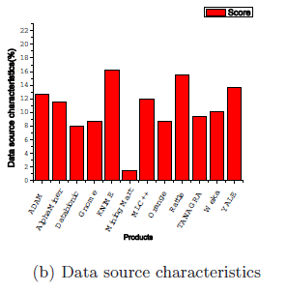
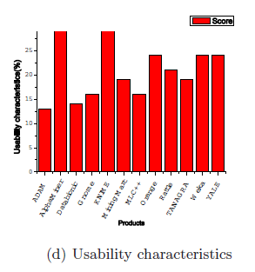
Rapid miner (YALE)
Data source aspect:
Does not support ODBC and Access data sources
Usability aspect:
Does not support PMML
Very little guidance in the data mining process
Reported bugs by users
Data source characteristics
Usability characterstics
Notes:
Reuse of cases. All of them can reuse the cases. AlphaMiner, KNIME,
and Rattle can export models in PMML format, which means that they can
share models with other PMML compliant applications

Slide 7

Weka
Data source aspect:
Does not support Excel, Access,ODBC,MySQL,Oracle
Functionality aspect:
Supports most required algorithms
It is not capable of multi-relational data mining
Usability aspect:
Does not support PMML
Extensibility allowed – a plus
Notes:
NE podržava značajan broj ulaznih tipova podataka.
Podržava određeni broj standardnih algoritama. Nije u stanju da zaključuje na osnovu baze koja ima više tabela povezanih relacijama, već je neophodno koristiti poseban softverski alat koji pretvara skup povezanih tabela u jednu tabelu koja je pogodna za obradu u Weka –i.
It is not capable of multi-relational data mining, but there is separate software for converting a collection of linked database tables into a single table that is suitable for processing using Weka^{[4]}.
Weka je dostupna za proširivanje, tako da je ovo njen plus,

Slide 8

Knime as a solution
Better than others because:
Uses simple and intuitive GUI
Easy node configuration and execution
Based on Eclipse platform
Many relevant examples
Useful help – node description
Good for begginers
Notes:
Better than others because :
Uses simple and intuitive GUI- can be used by any scientist , regardless on his IT technologies knowledge
Easy node configuration, and clear execution
Based on Eclipse platform
Many relevant examples
Useful help – node description
Good for begginers as well as experienced users
. KNIME has been developed from day one using rigorous professional software engineering processes since it was clear from the beginning that it was to be used in large scale enterprises.
The initial goal was to create a modular, highly scalable and open data processing platform which allowed for the easy integration of different data loading, processing, transformation, analysis and visual exploration modules without the focus on any particular application area. The platform was intended to be a collaboration and research platform and should also serve as an integration platform for various other data analysis projects out there.
In 2006 several pharmaceutical companies started using KNIME and a number of life science software vendors began integrating their tools into KNIME. Later that year, after an article in the German magazine c't^{[1]}, users from a number of other areas joined ship. As of summer 2009, KNIME is in use by over 2.000 actual users (i.e. not counting downloads but users regularly retrieving updates when they become available) not only in the life sciences but also at banks, publishers, consulting firms, and various other industries but also at a large number of research groups world wide.

Slide 9
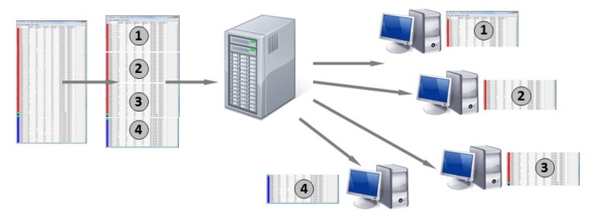
Originality
Integration of various Python,R,Perl,Java snippets
Portability – PMML, XML
KNIME Cluster Execution – gain in performance
KNIME allows users to:
visually create data flows
selectively execute analysis steps
inspect results
Notes:
Open source – easily extensible
Portability – workflow ‚nodes and settings are XML files
Integrates Python, R, Perl, Java snippets, jdbc
KNIME Cluster Execution tackles this problem by providing a thin connection layer between KNIME and the cluster, which allows every node running in KNIME and every application integrated in KNIME to be executed on the cluster. Submission of data to the cluster and collection of the results is made very simple. Long-running analysis workflows can be executed on the compute cluster, thus releasing local resources for other productive work. Performance An important advantage is the gain in performance for calculation intensive workflows.
KNIME is written in Java and based on Eclipse and makes use of its extension mechanism to allow for plugins providing additional functionality
Additional plugins allow to add modules for text, image, and time series processing and the integration of various other open source projects, such as R (programming language), Weka, the Chemistry Development Kit, and LibSVM.
KNIME is implemented in Java (software platform) but also allows for wrappers calling other code in addition to providing nodes that allow to run Python, Perl and other code fragments
-----------------------------------------------
This modularity and extensibility permits KNIME to be employed in commercial production environments as well as teaching and research prototyping settings

Slide 10
Time is on Knime’s side
More and more companies use it
Intensive development of new SW features
KNIME Enterprise Server
KNIME Cluster execution
Open source – easily extensible
Modules for text and image processing
Notes:
The Enterprise server provides the same functionality as Server Lite but adds user access management. User classes can be assigned and privileges on workflows and the workflow execution can be given to individual users or user classes. In addition scheduled execution capabilities enable workflows to be executed at specific dates and times. The Enterprise Server also provides access to KNIME workflows via Web Services in order integrate with custom build applications and to operate in your service oriented architecture (SOA).
KNIME Enterprise Server provides different repositories and allows implementation of workflows from different user interfaces
Feature Overview
Collaboration
Workflow repository: pre-configured workflows on server repository, which can be applied to new data sets
User rights management
Secure user authentication and role management
User rights at workflow level:
Read, modify workflows
Execute workflows
Create or remove workflows in server repository
Remote and scheduled execution
Execution of compute- or data-intensive workflows on the server
Scheduled execution By time: execute workflow for data import, or report generation at certain time intervals (daily, weekly, etc.)
Advantages
Share Workflows Workflows can now be shared among team members on a central server.
Control Access The access to the workflows and their execution can be controlled through user rights and user classes.
Remote Execution The remote execution capabilities relieve local PC resources when performing complex calculations.
Scheduled Execution Scheduling lets you execute tasks on a single or repeated basis and is tightly integrated into the KNIME user interface.
SOA Integration Workflows can be accessed as web services which makes integration into your corporate environment easy.

Slide 11
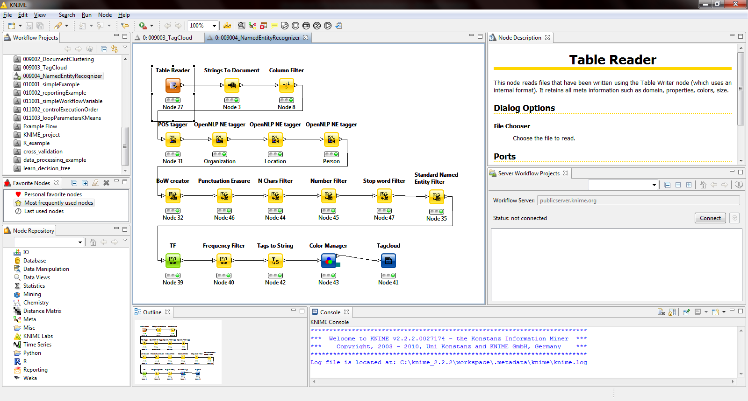
Example
Paleta osnovnih funkcionalnosti
Radna površina trenutno aktivnog projekta
Lista svih projekata
Detaljan opis selektovanog čvora
Lista dostupnih projekata na serveru
Lista svih postojećih čvorova grupisanih po funkcionalnosti
Konzola na kojoj se vide obaveštenja i greške u projektu

Slide 12
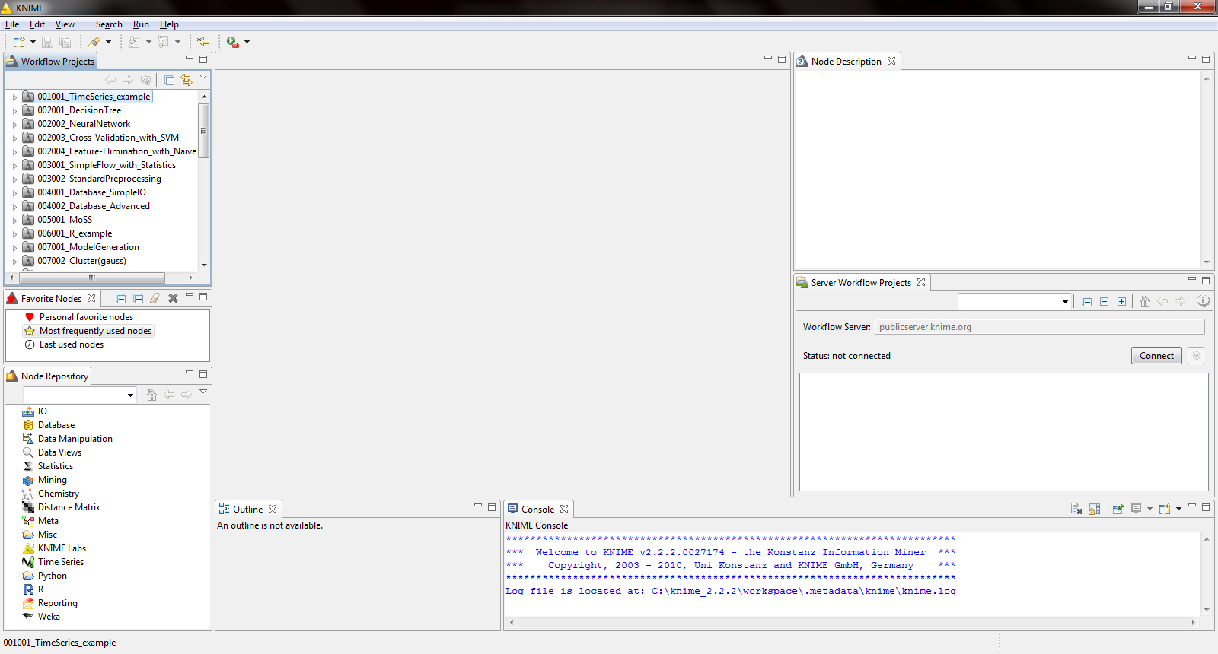
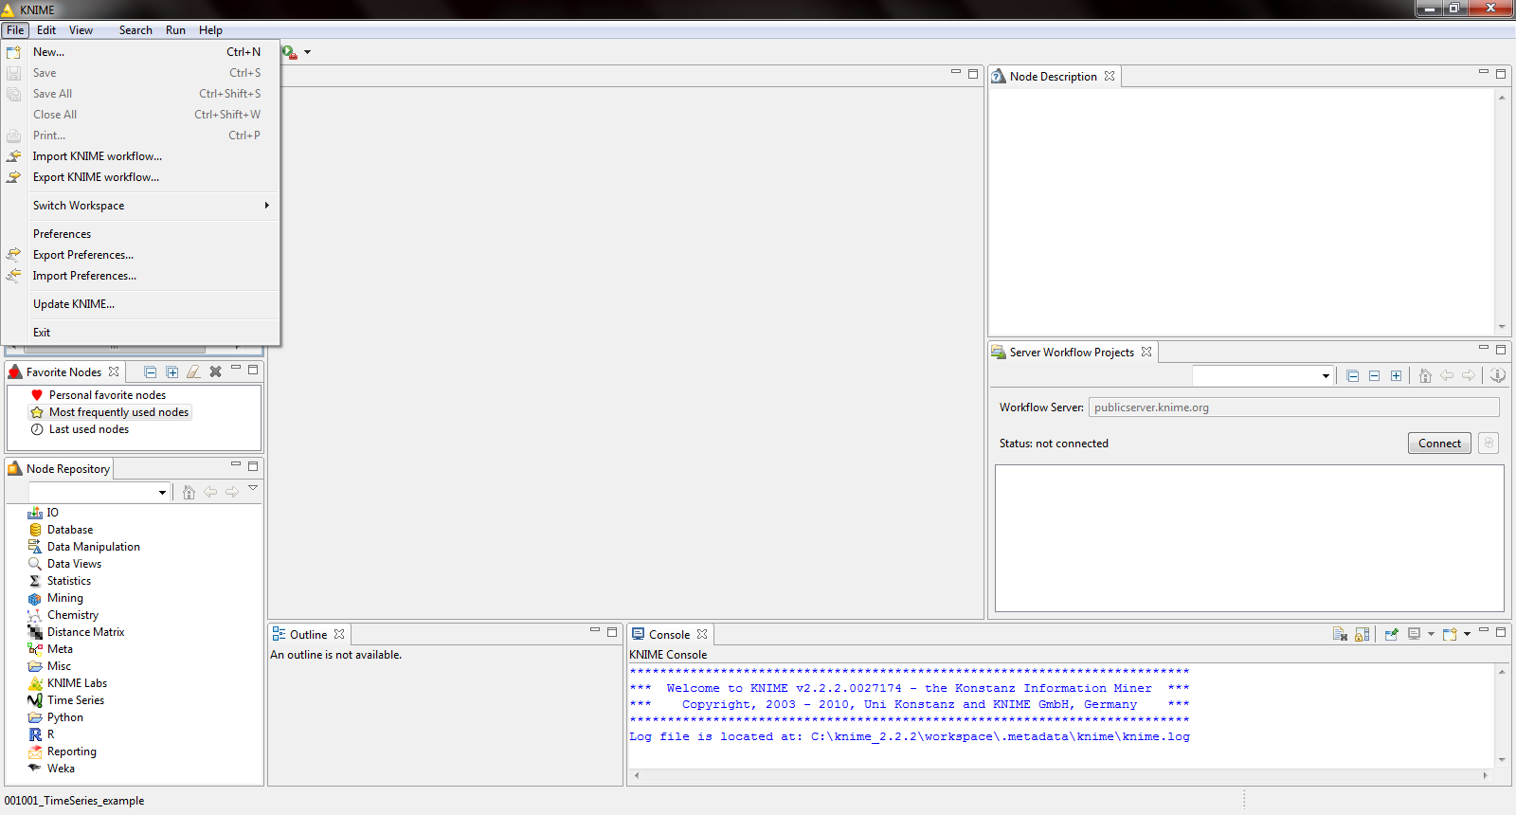
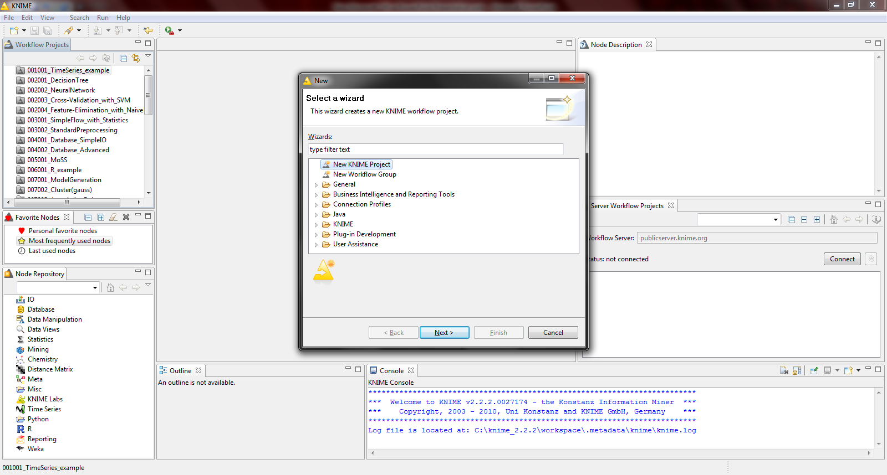
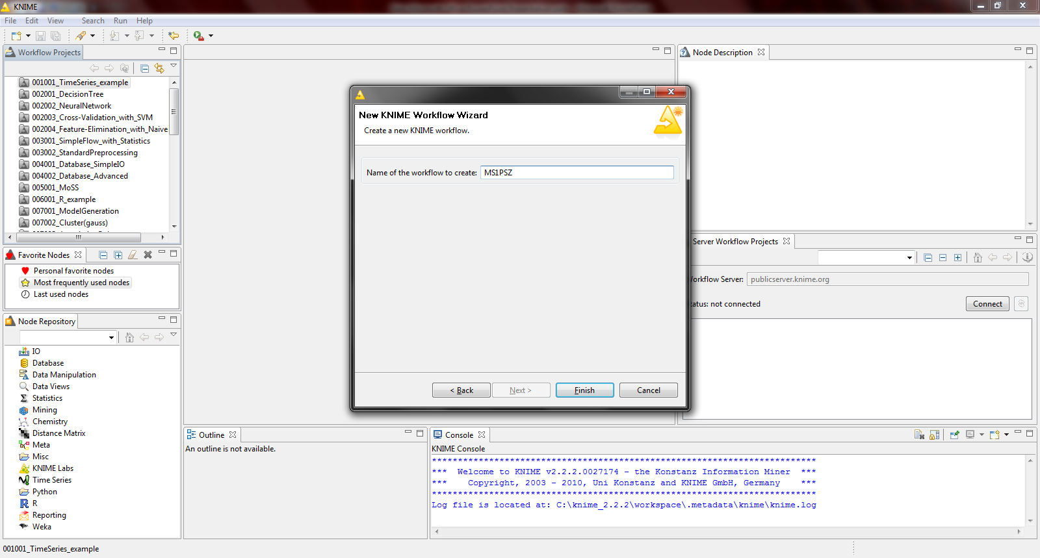
Example
Da biste otvorili novi projekat iz menija File izaberite New
Izaberite New KNIME Project i kliknite Next
Unesite ime projekta i kliknite Finish

Slide 13
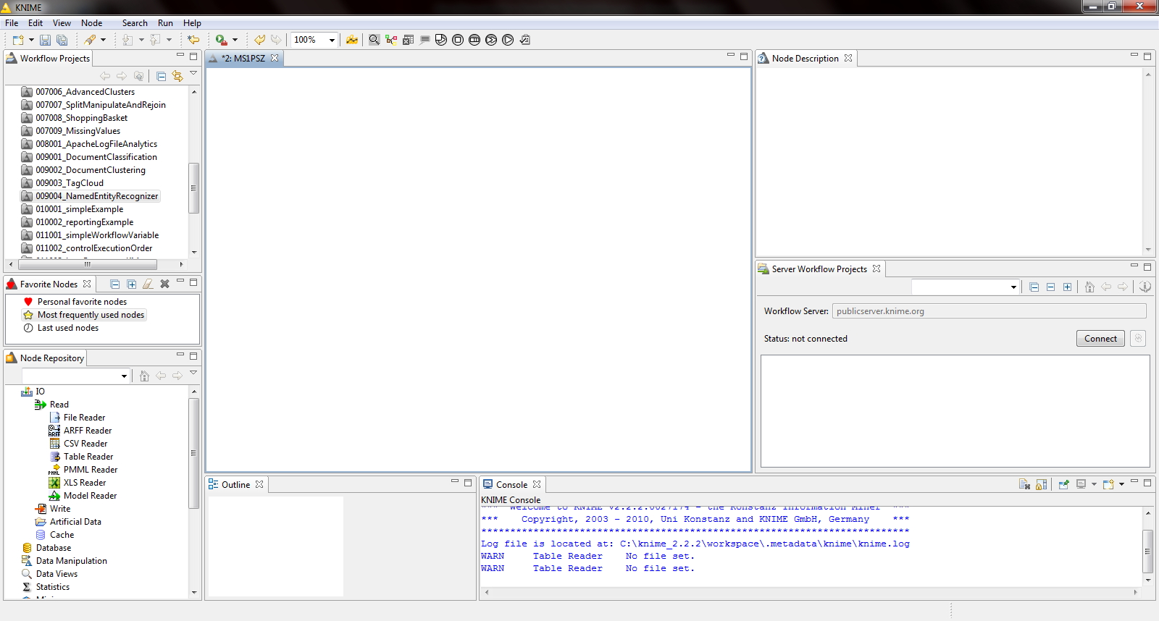
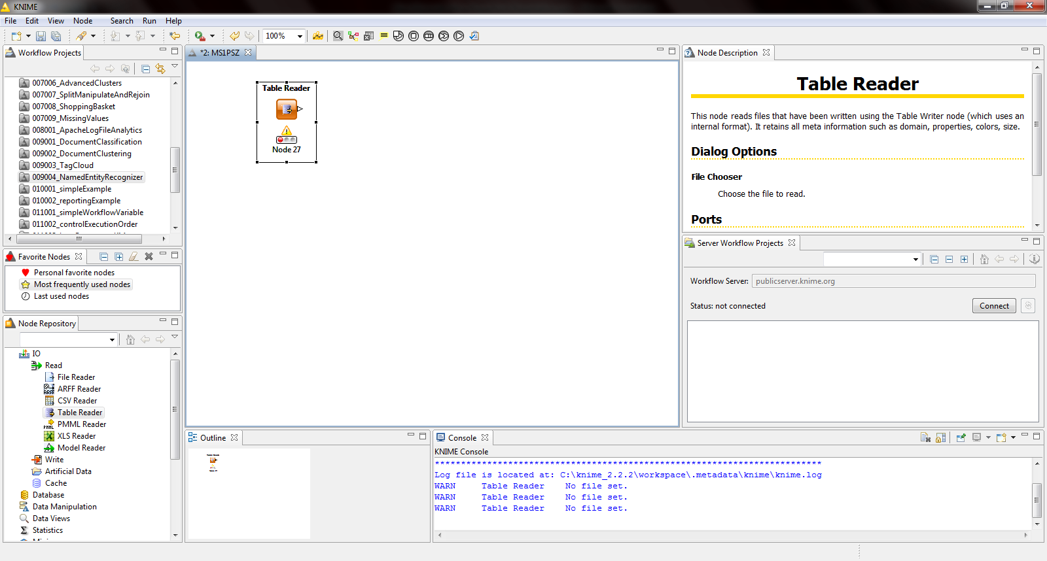
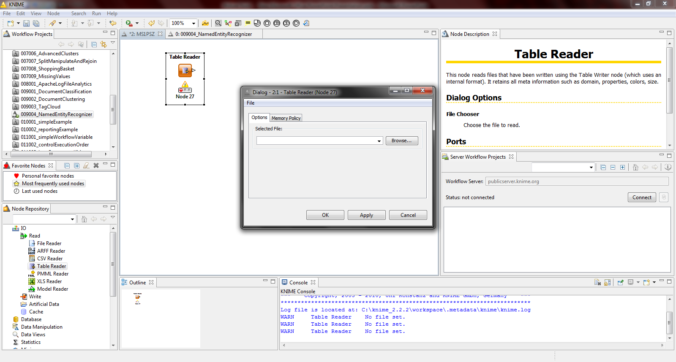
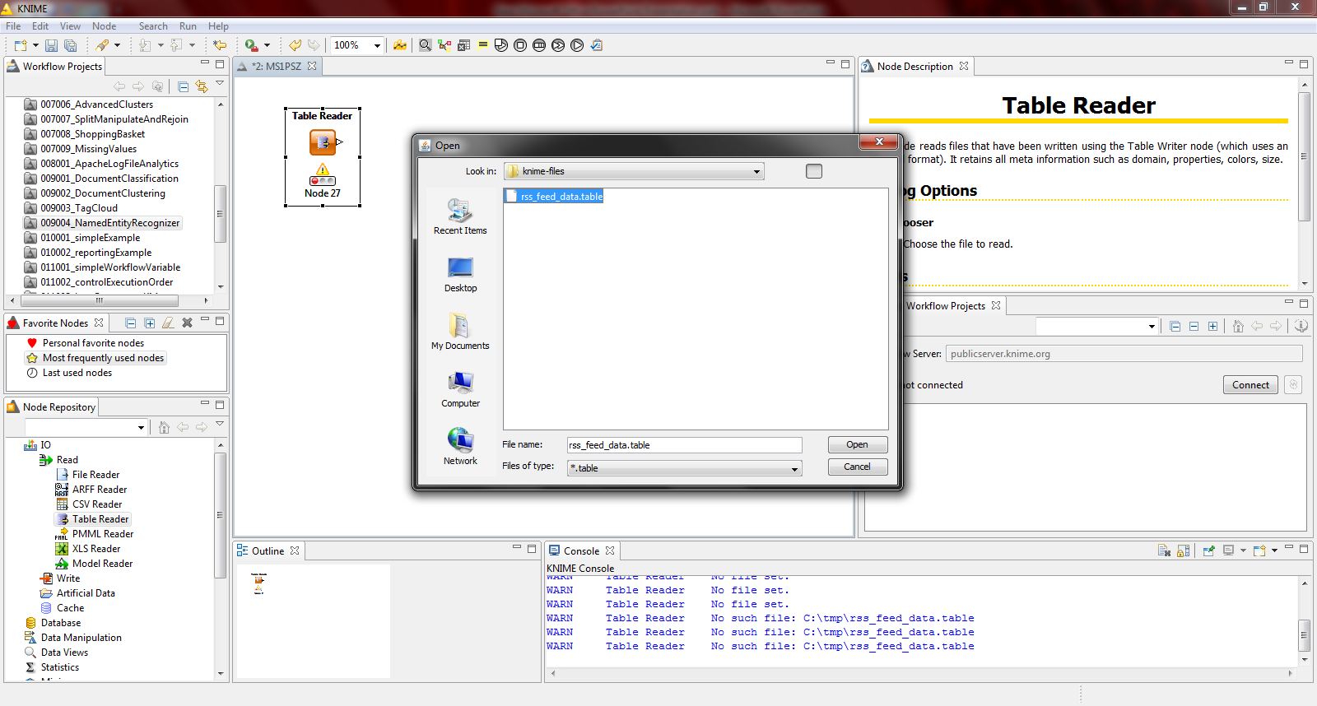
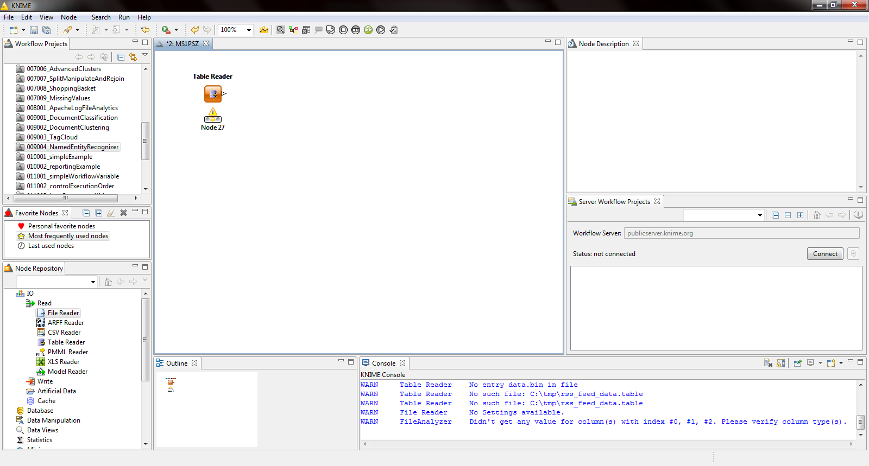
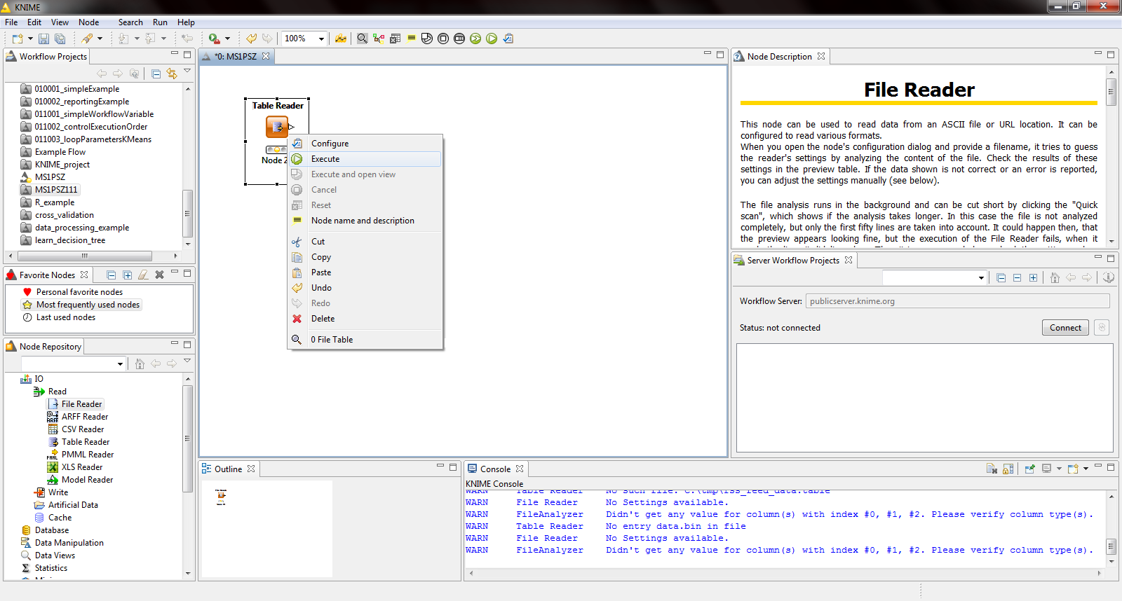
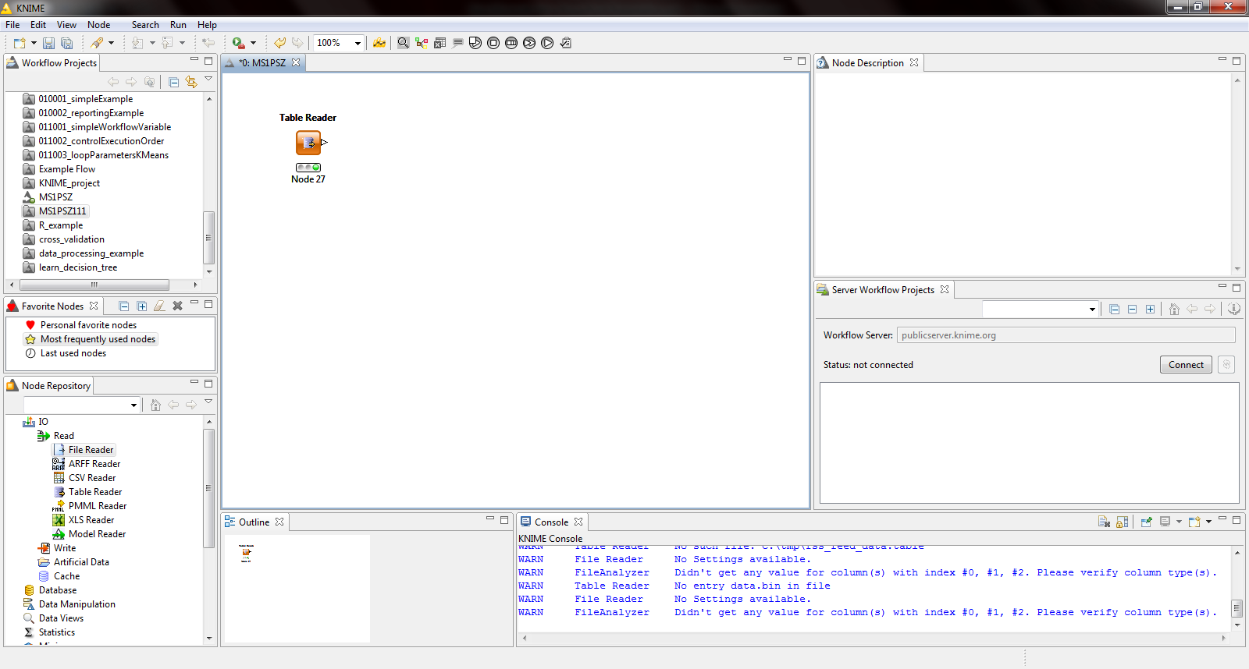
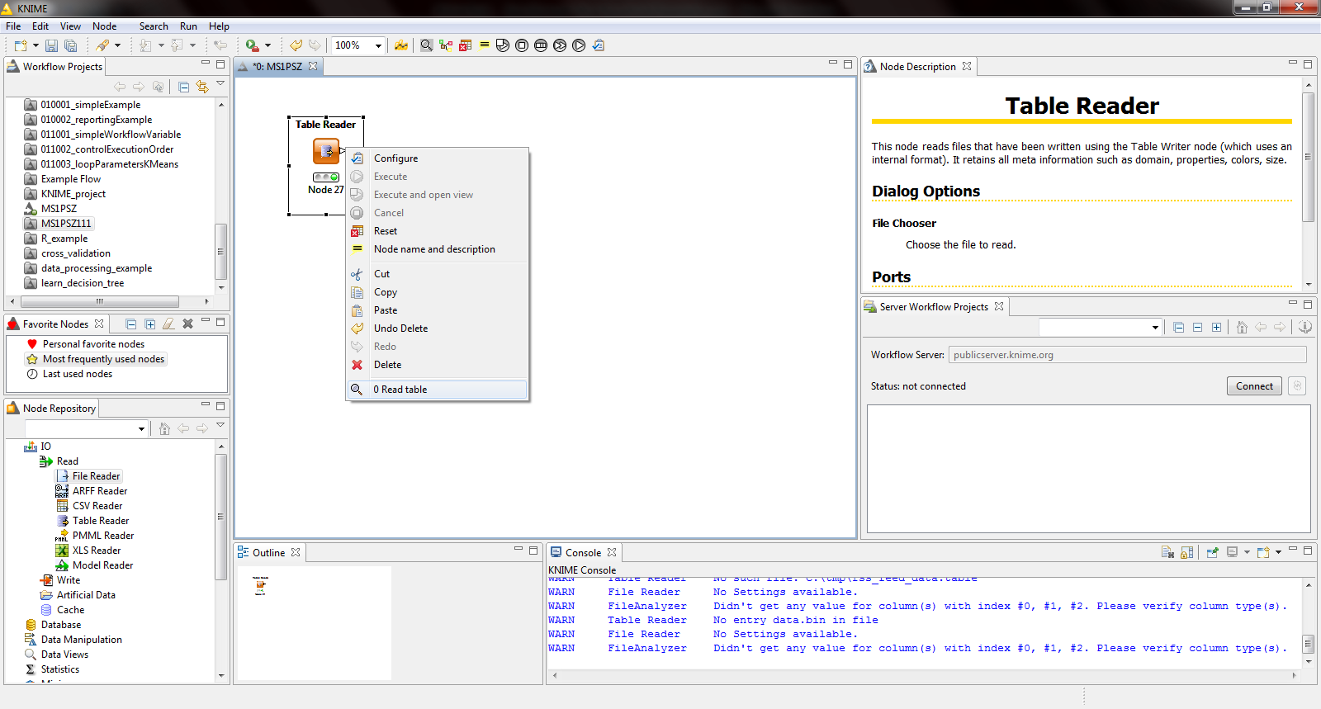
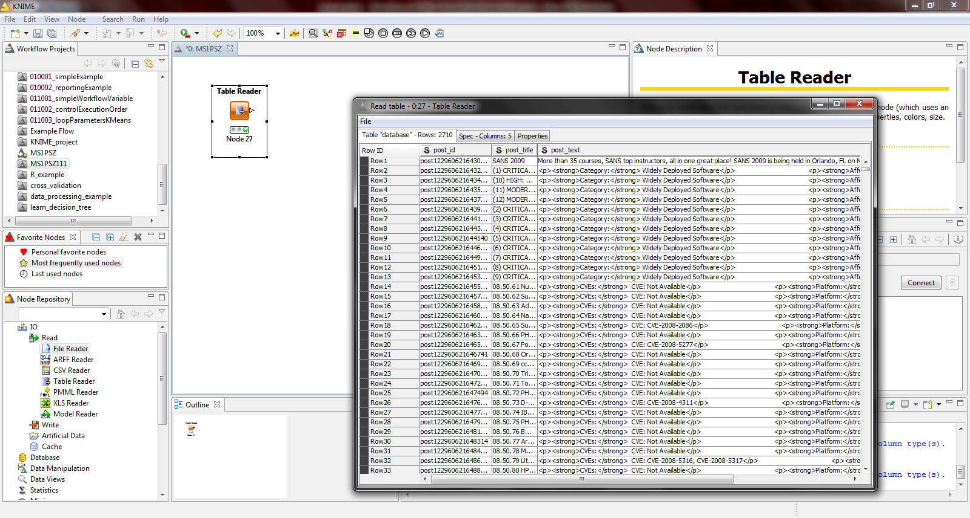
Example
Posle definisanja ulaznog fajla čvor prelazi u stanje ready
Izvršavanje čvora prelazi u treće stanje
Kliknite na Browse da odaberete putanju do fajla

Slide 14
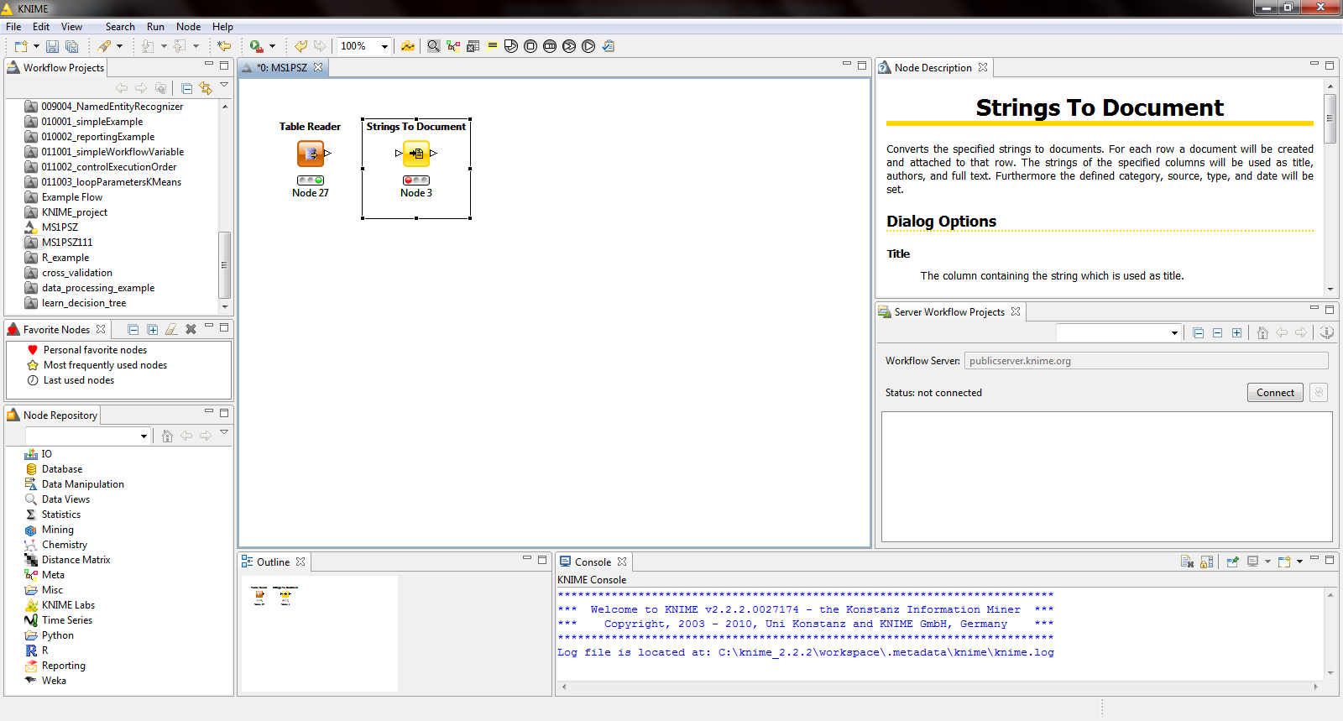
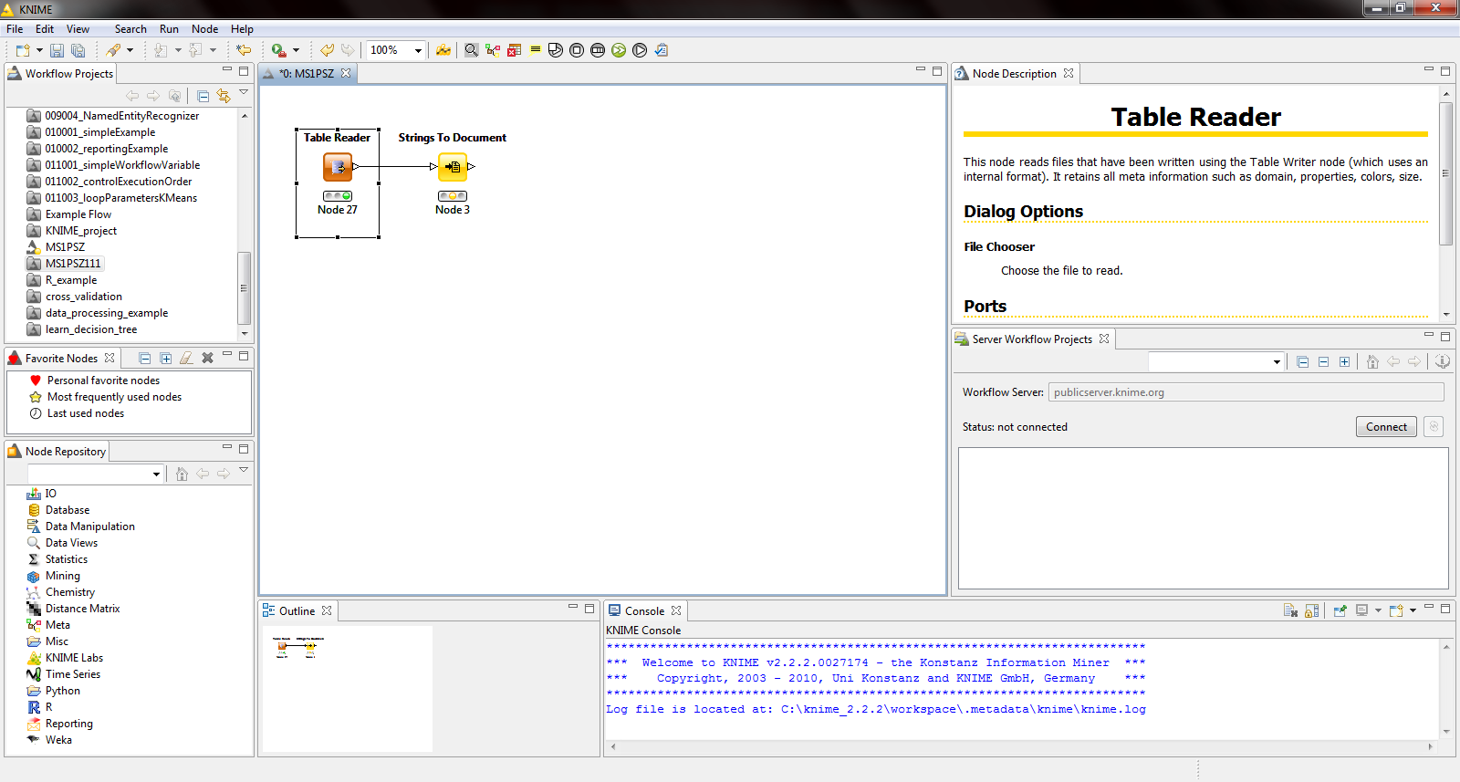
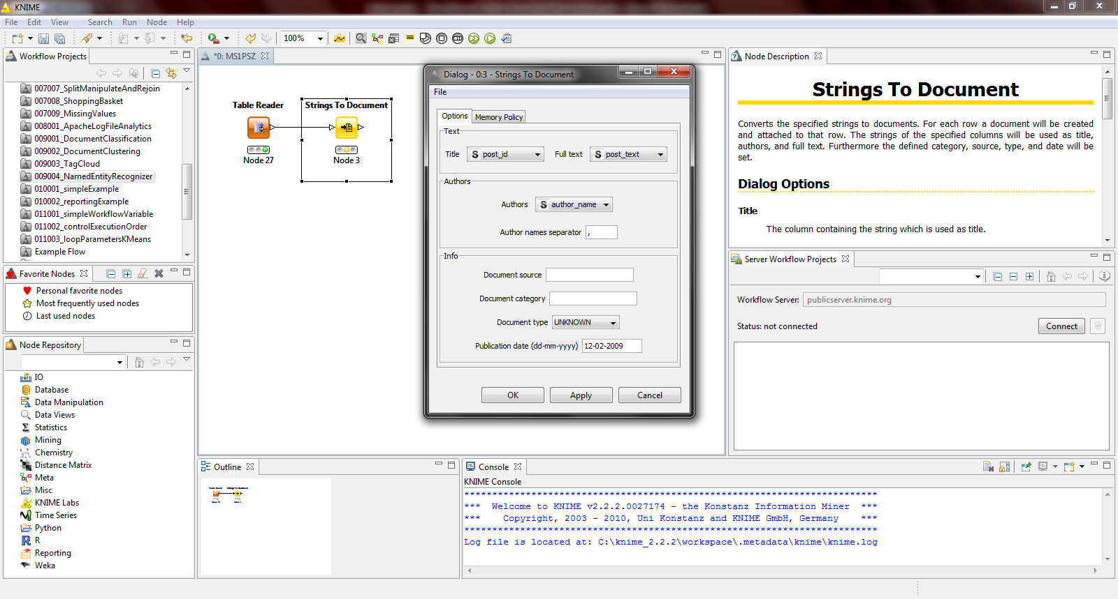
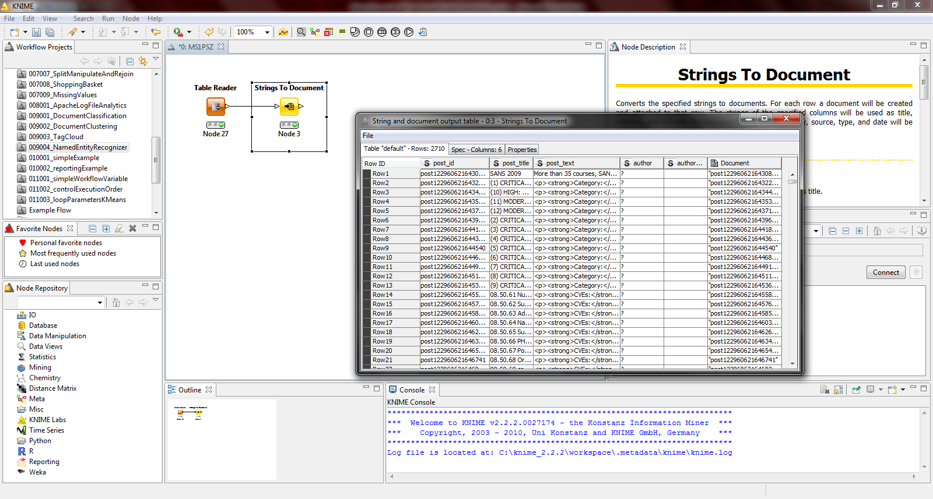
Example
Po izvršenju čvora dodaje se nova kolona u tabeli Document
Posle povezivanja čvor je spreman za izvršenje

Slide 15
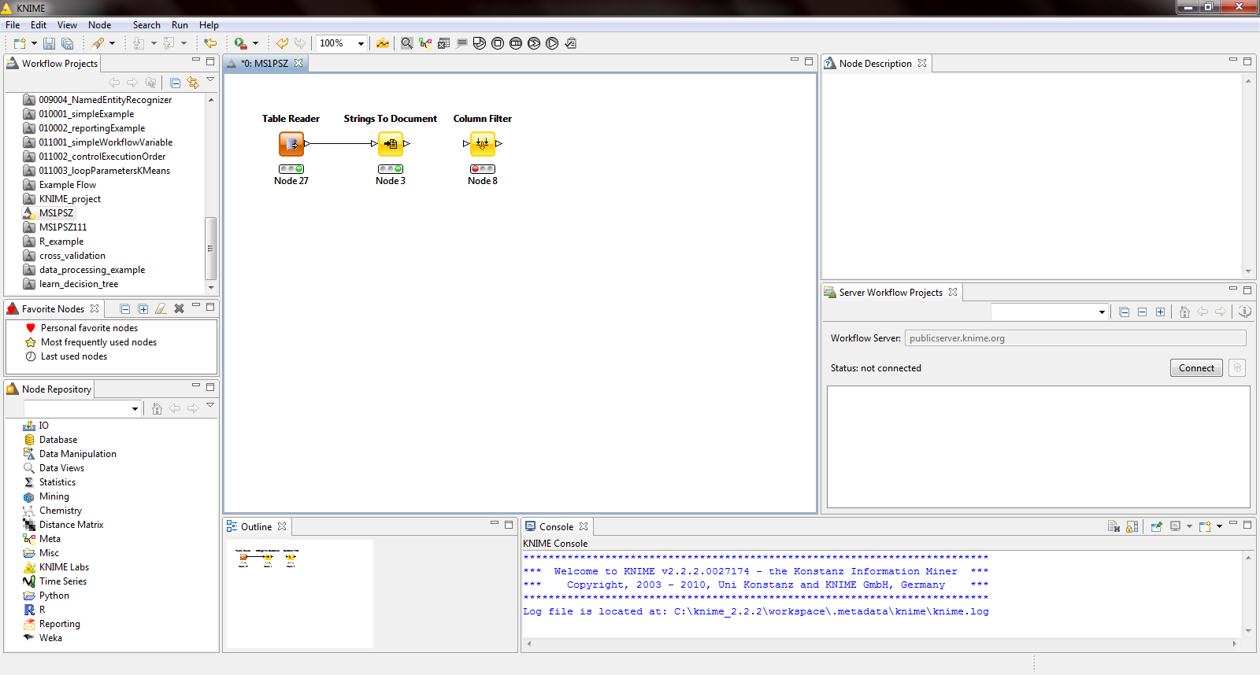
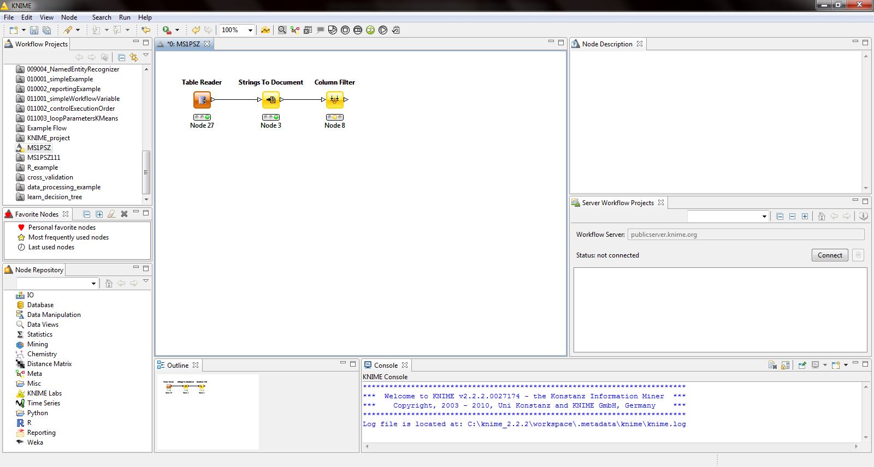
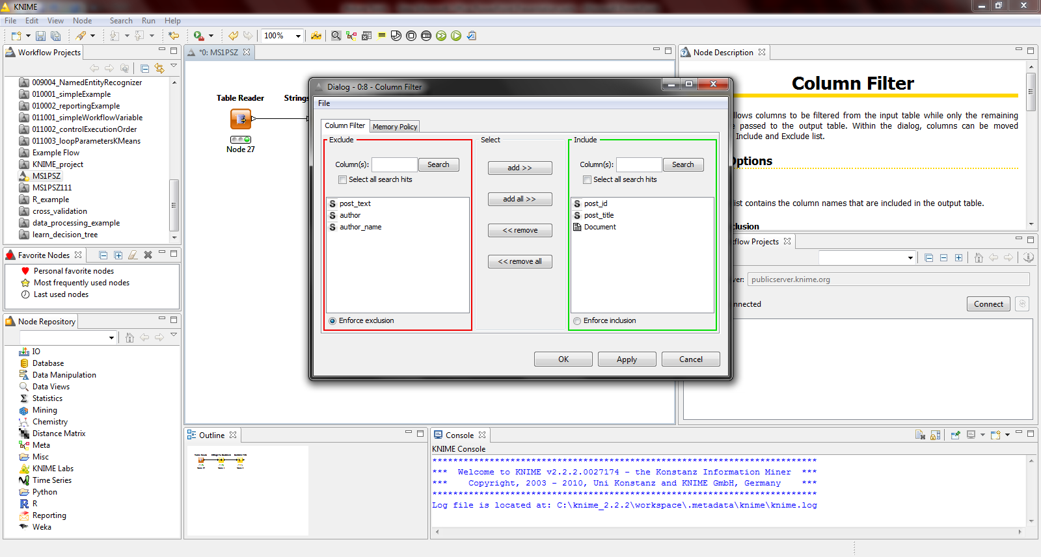
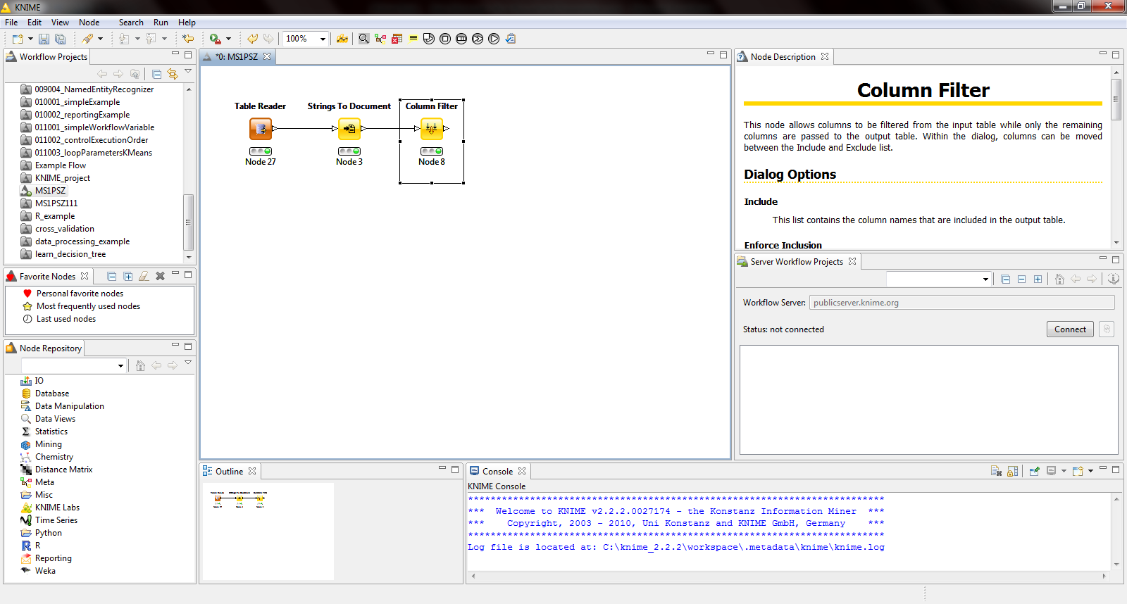
Example
Vrsi se odabir kolona koje zelimo da filtriramo

Slide 16
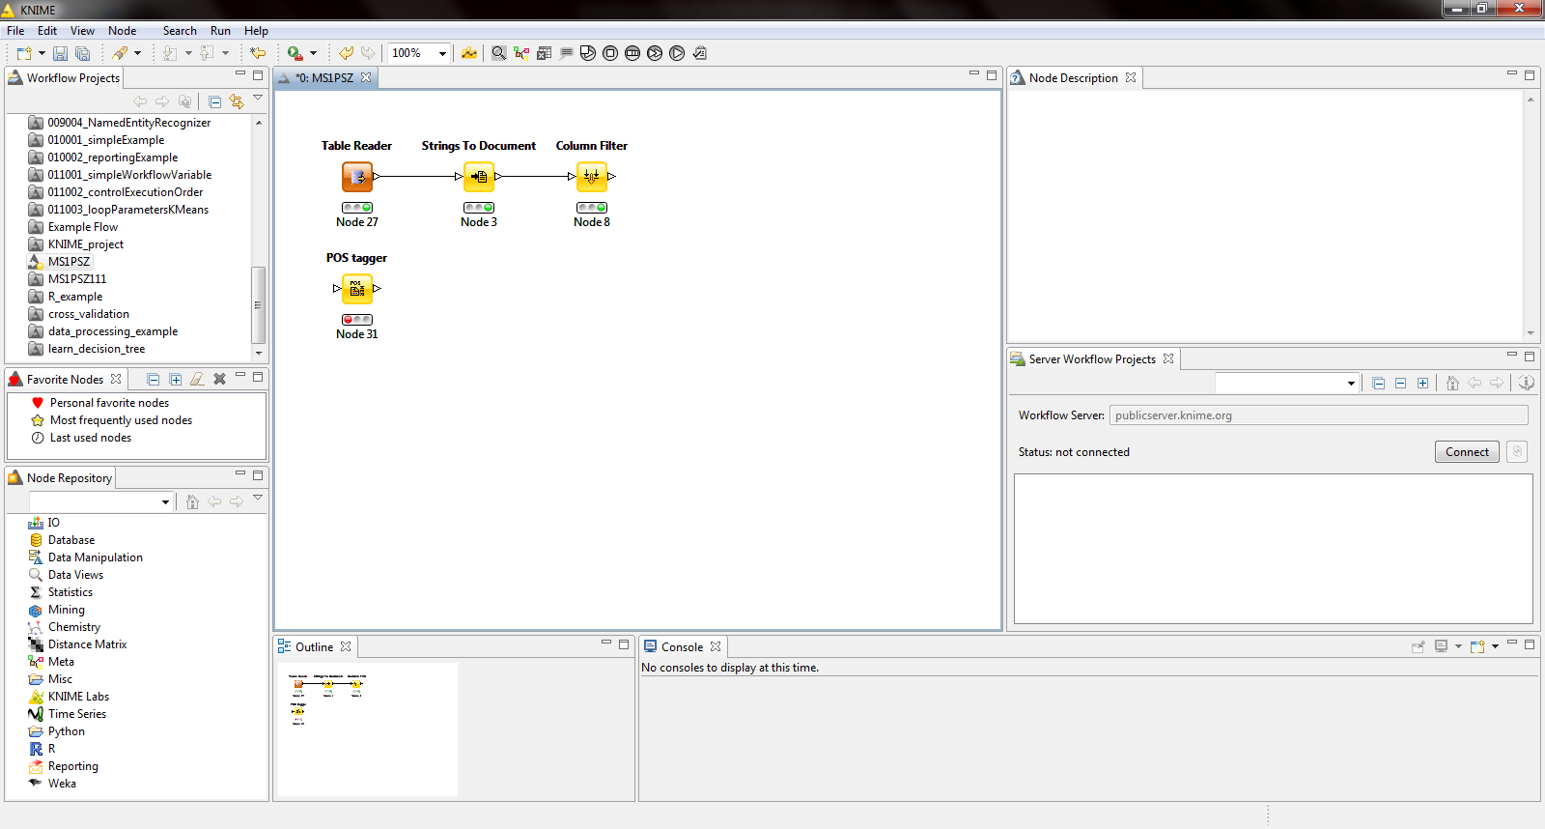
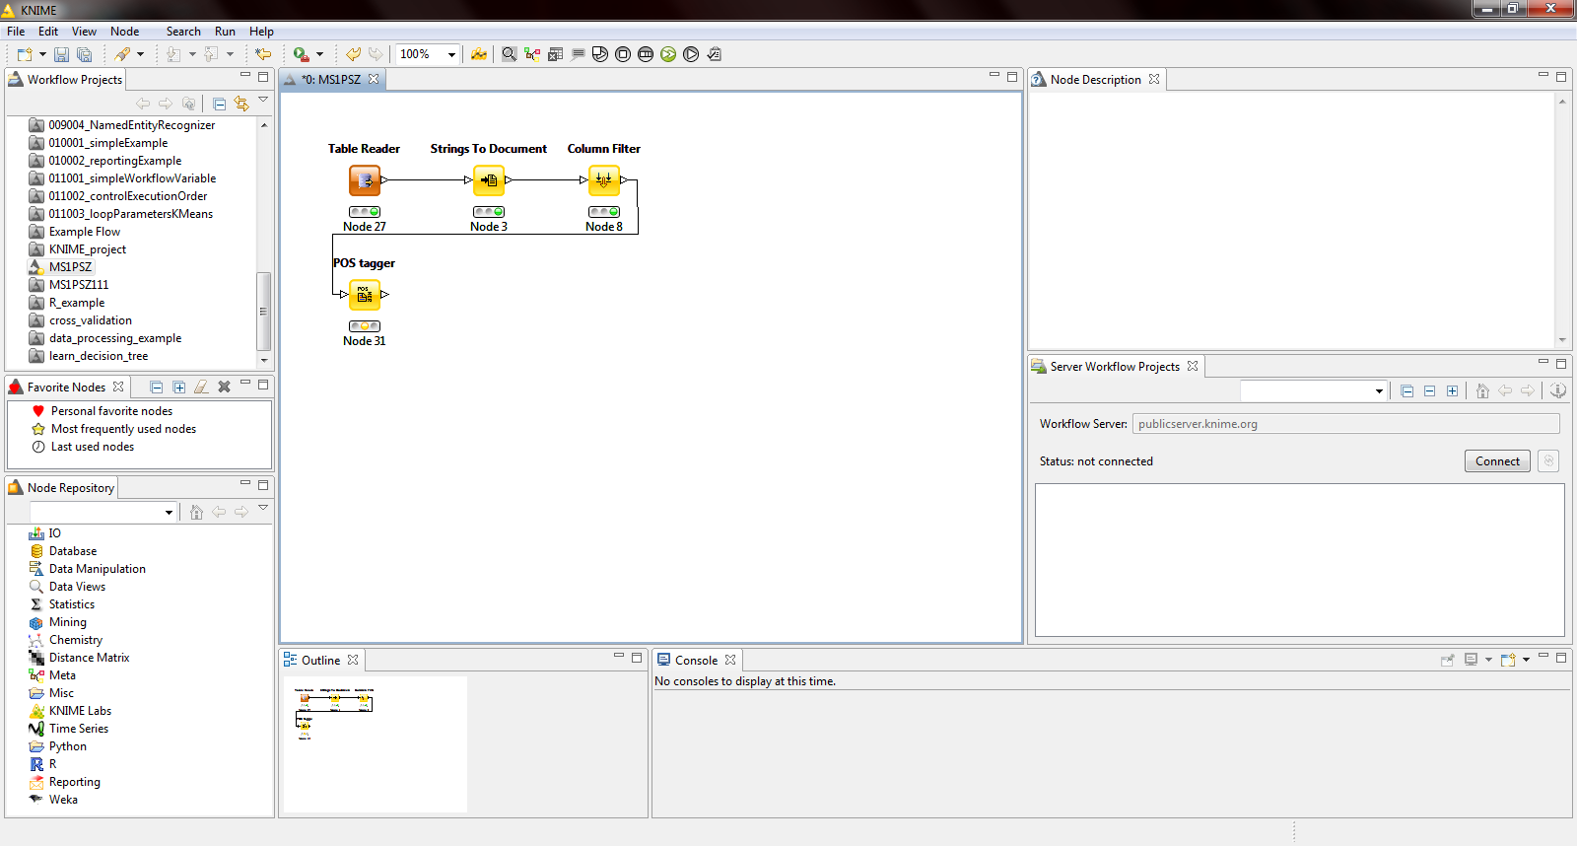
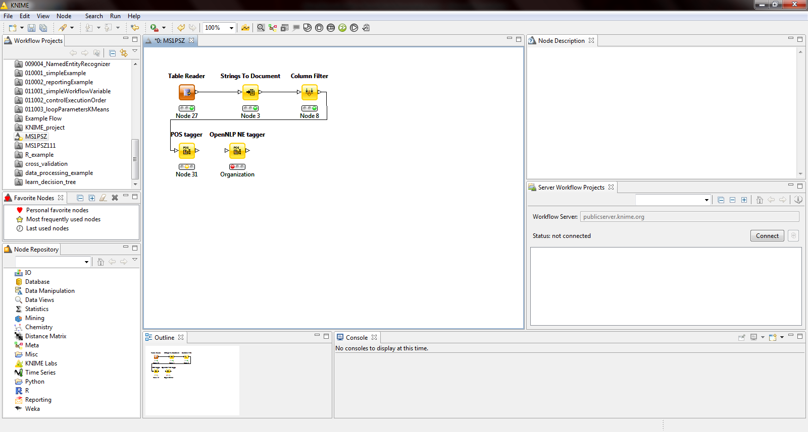

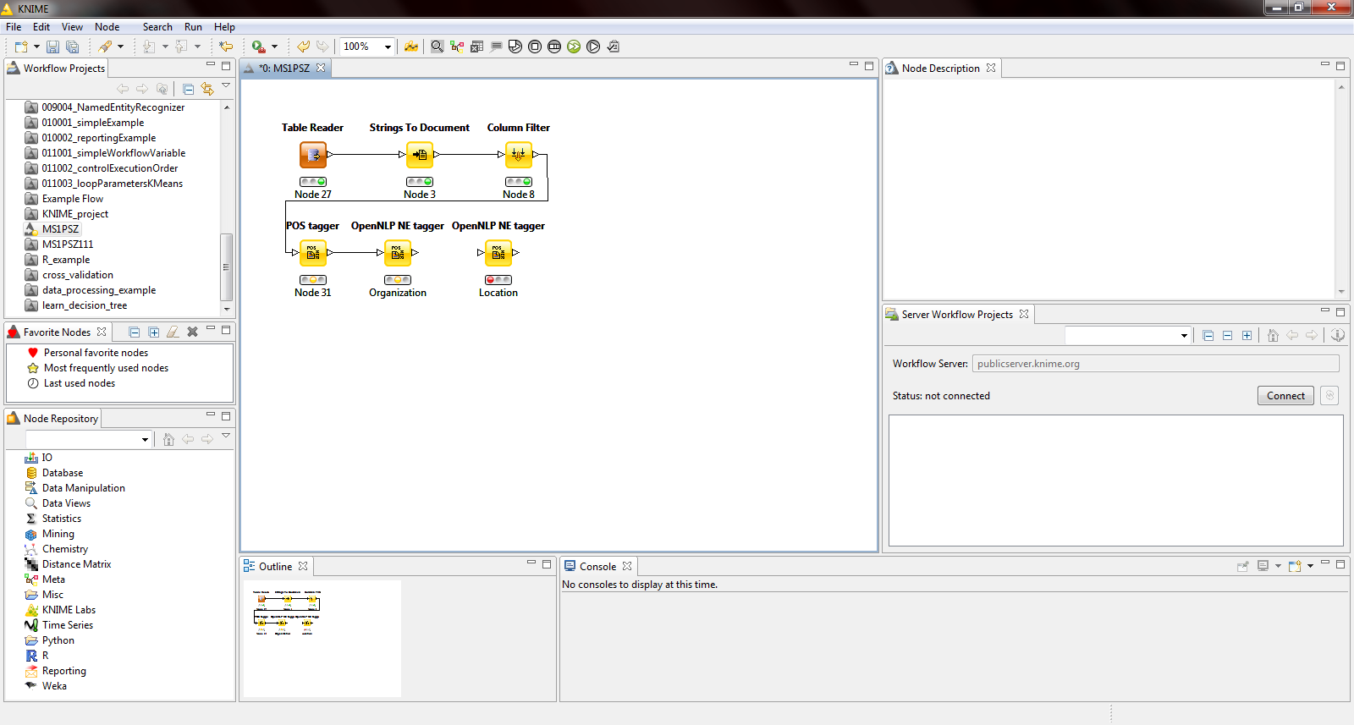
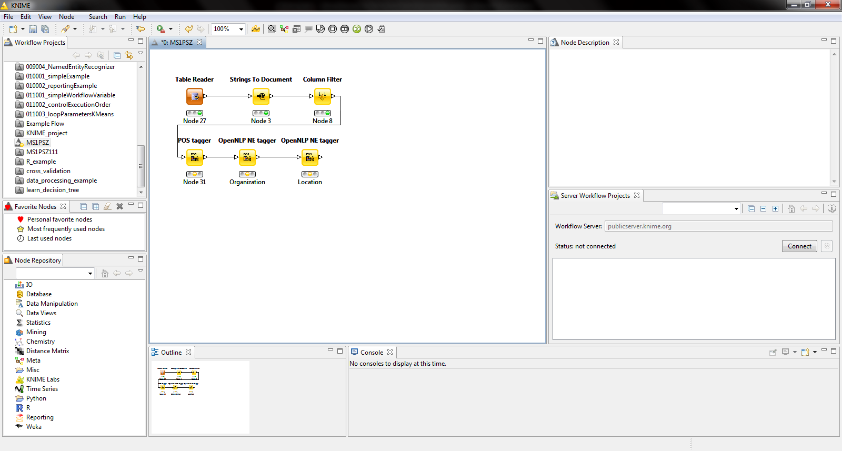
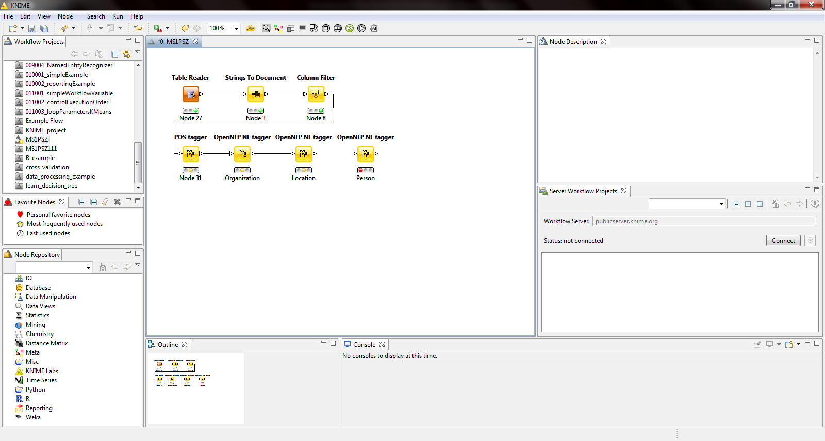

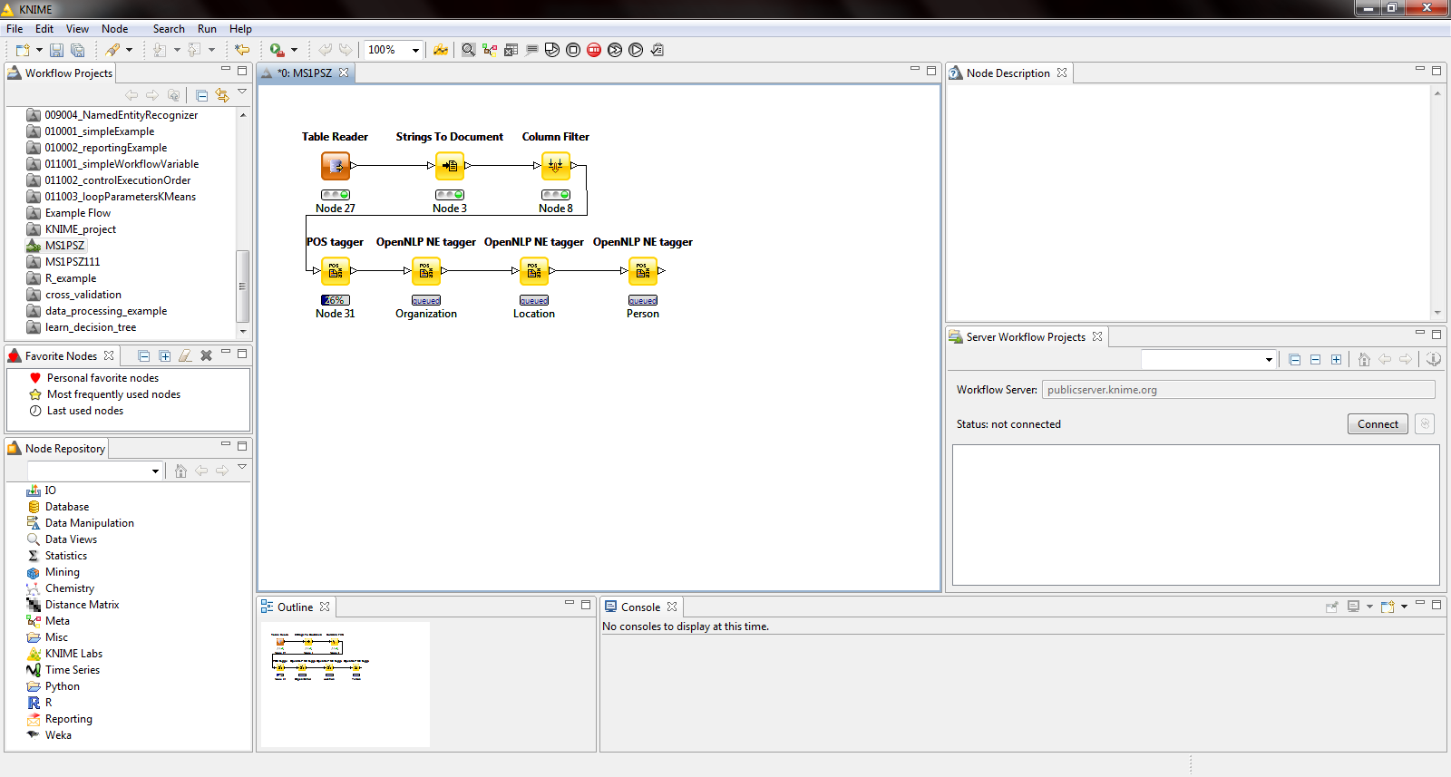
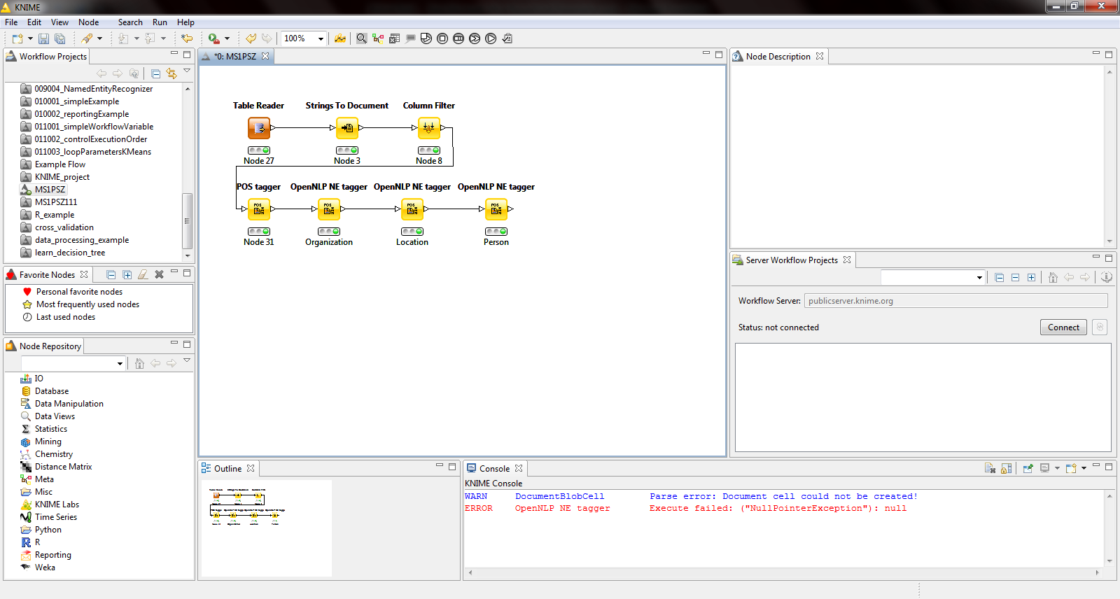
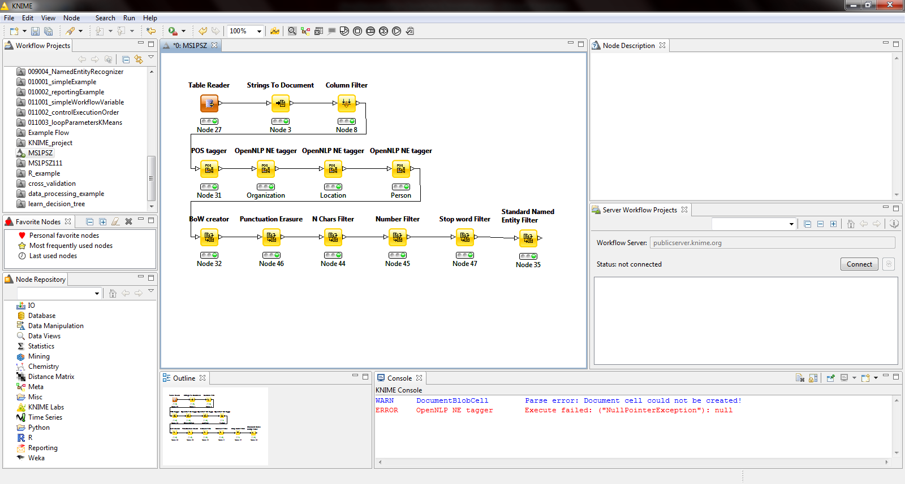
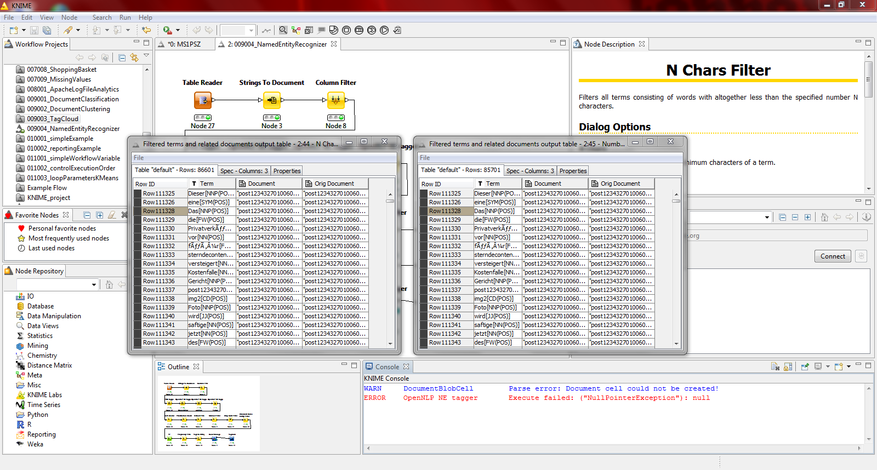
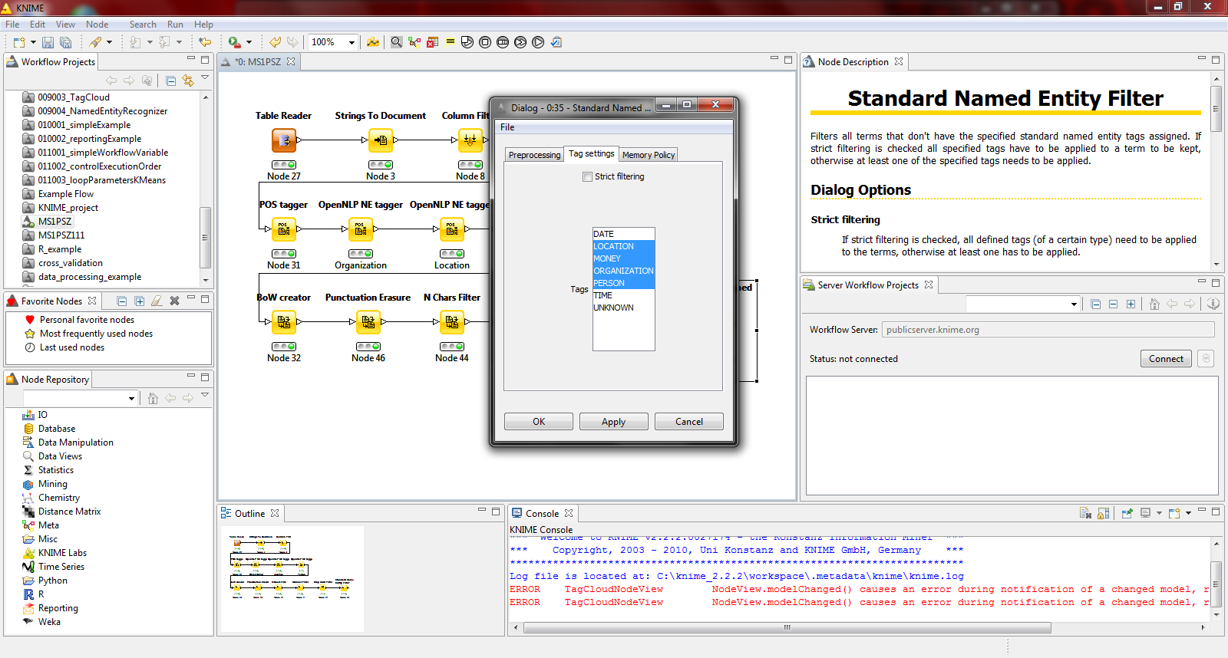
Example
Broj redova se smanjio usled filtracije

Slide 17
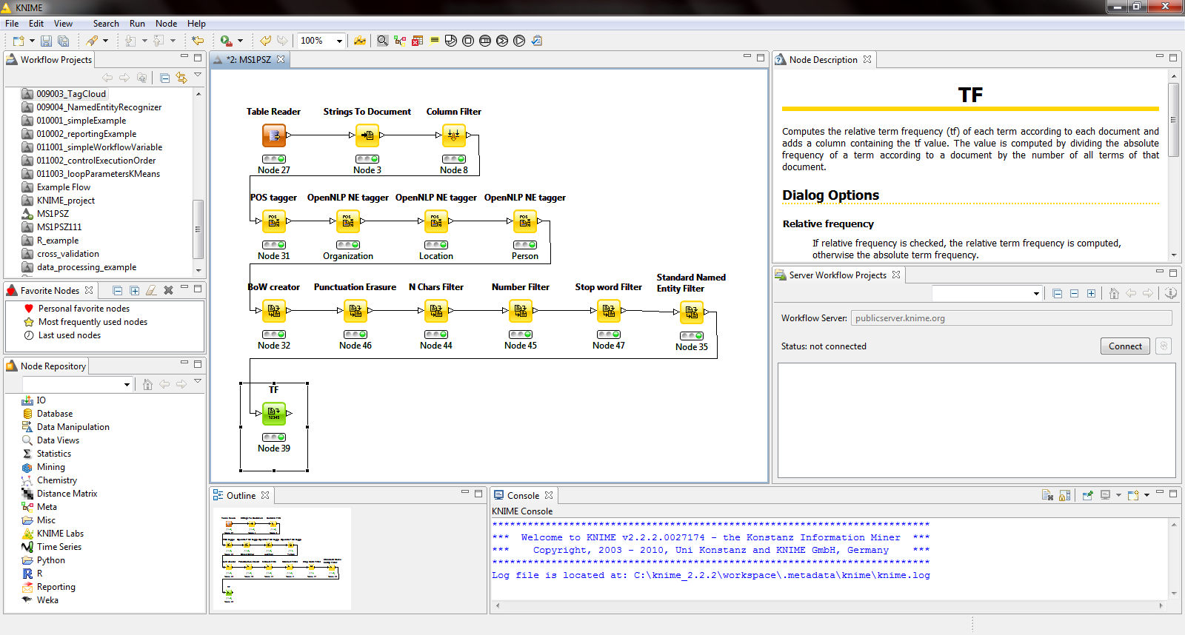
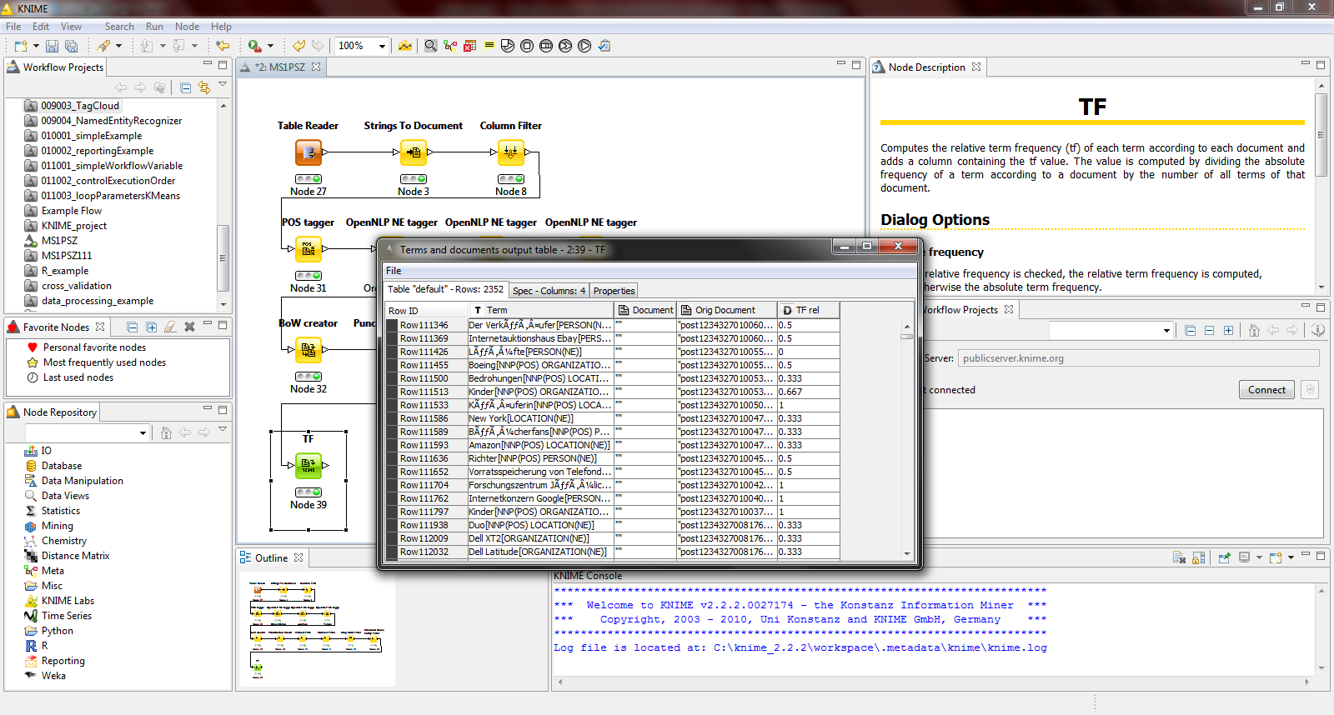
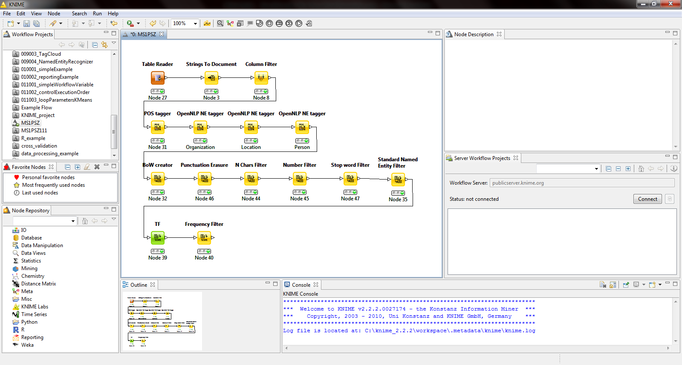
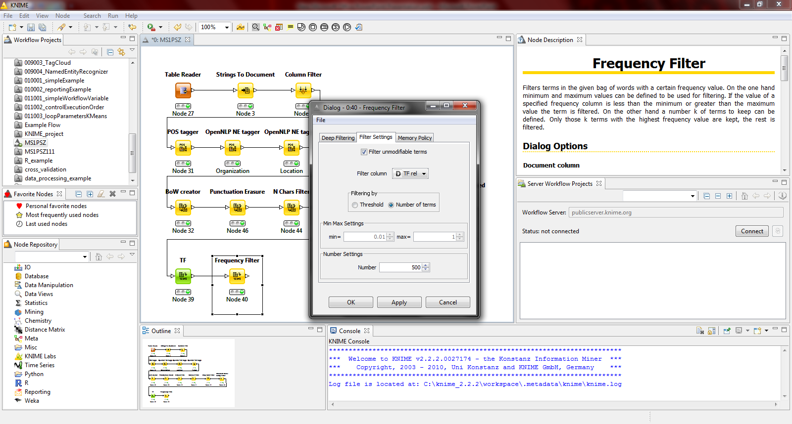
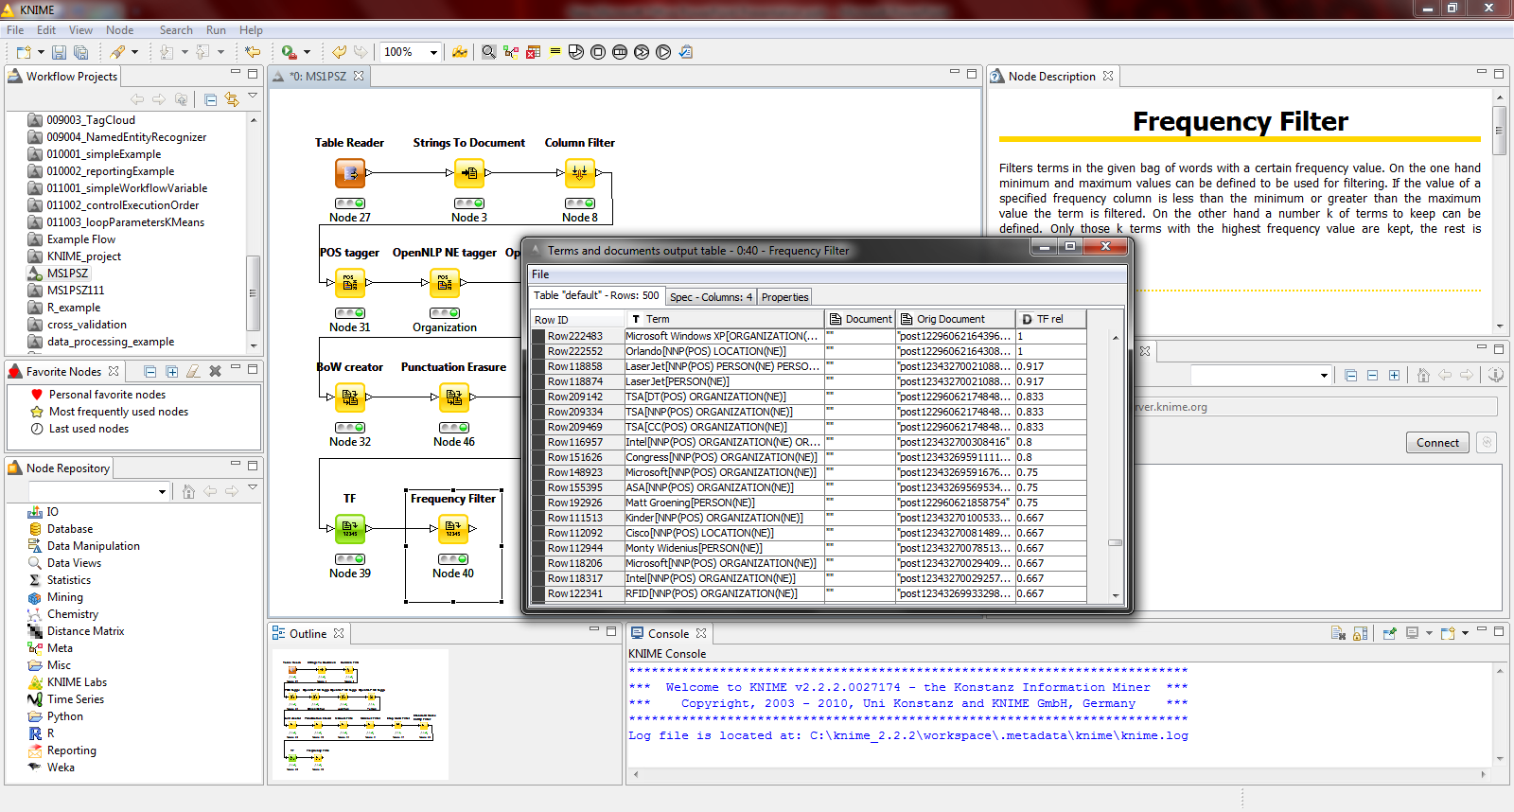
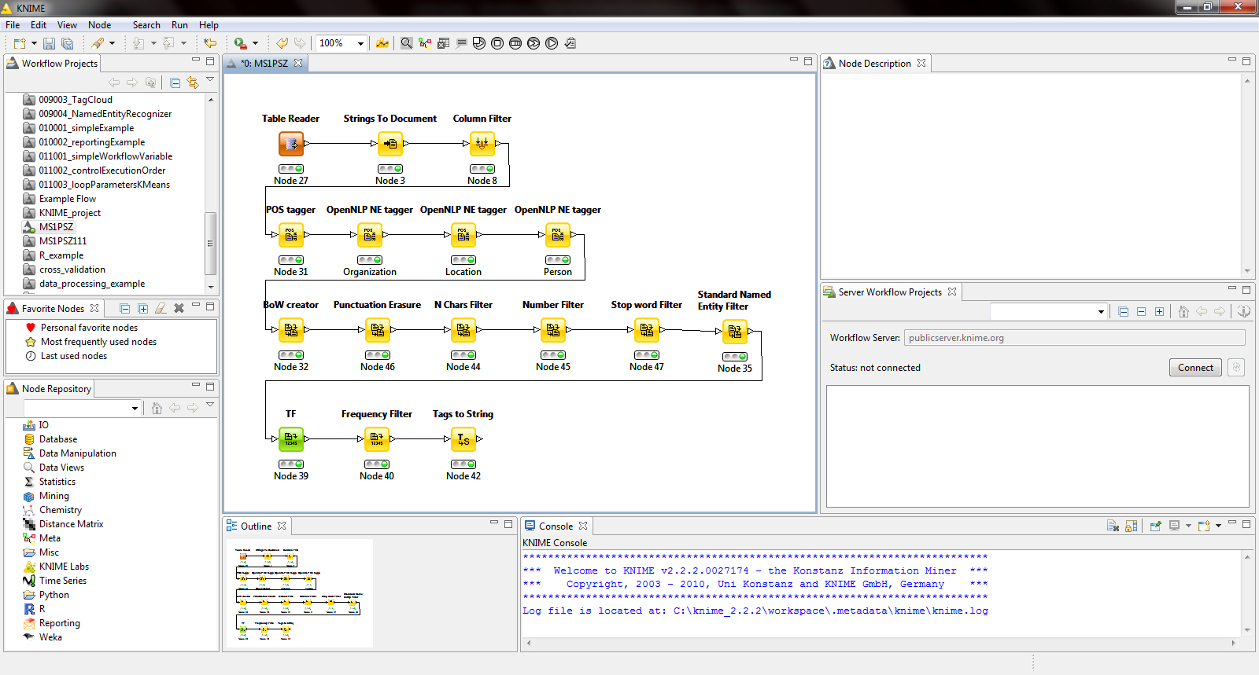
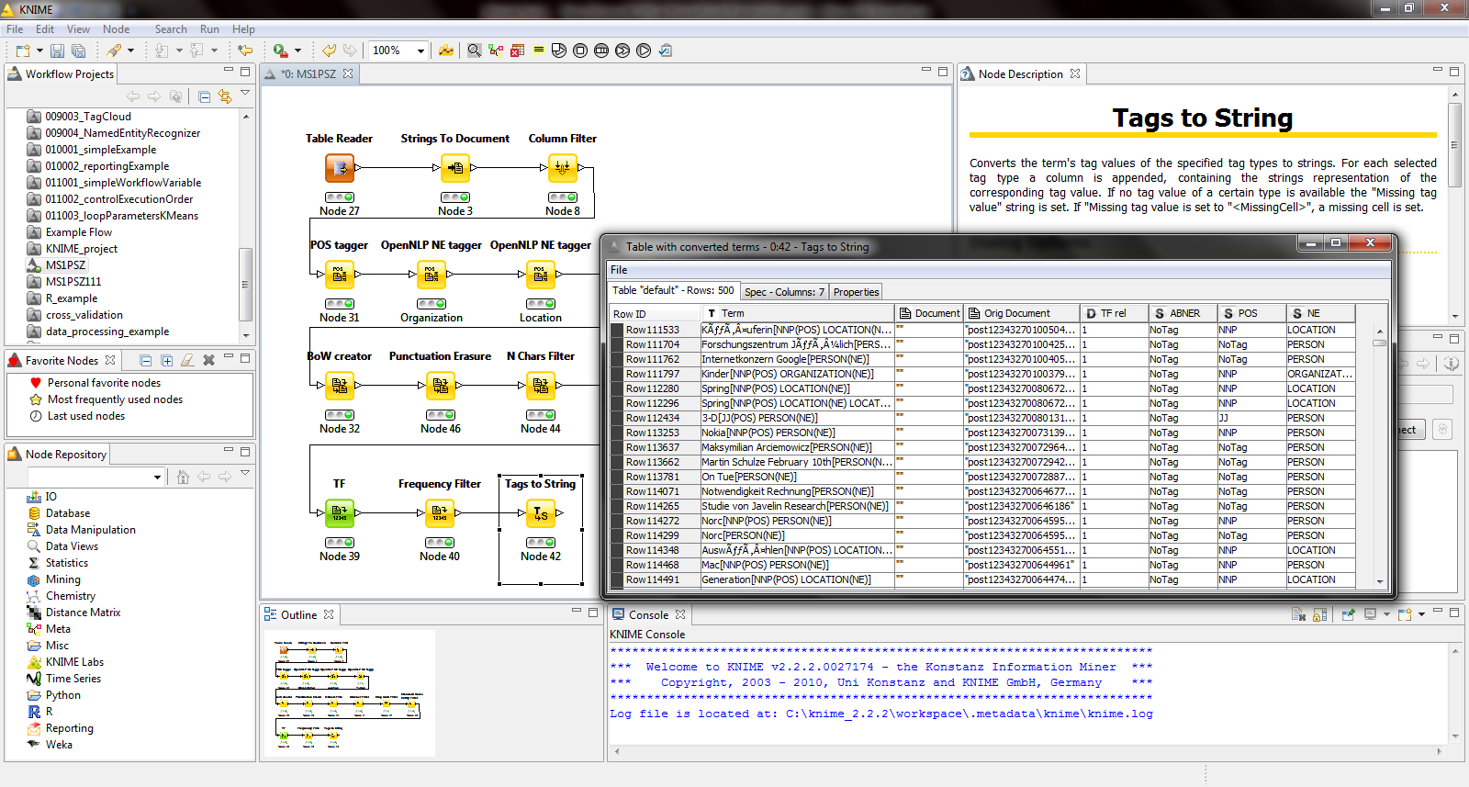
Example

Slide 18
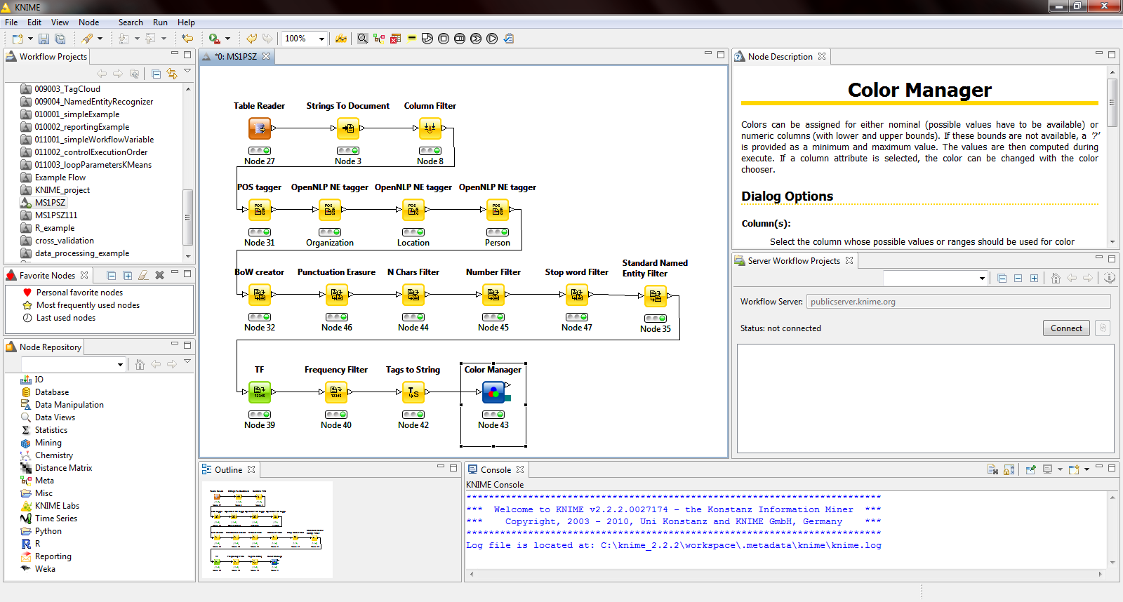
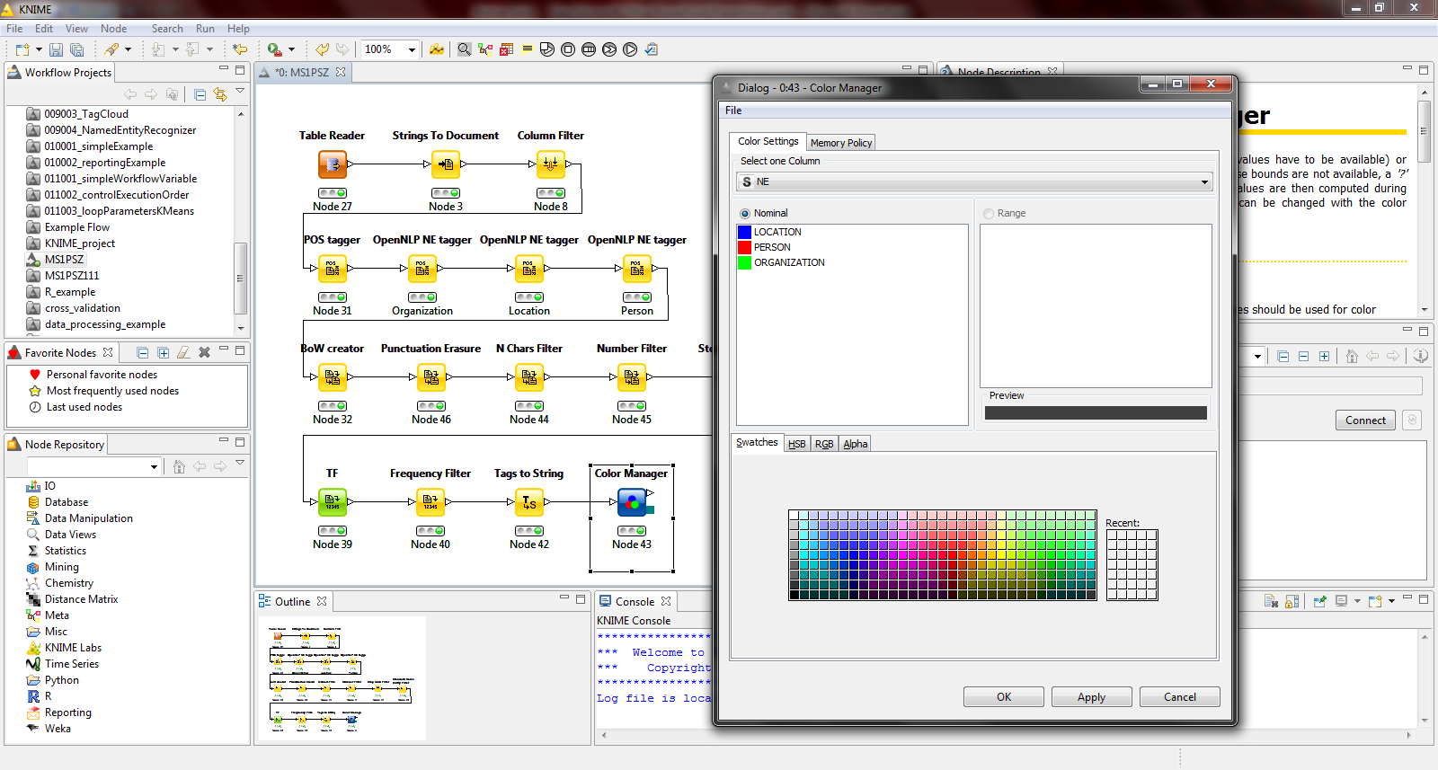
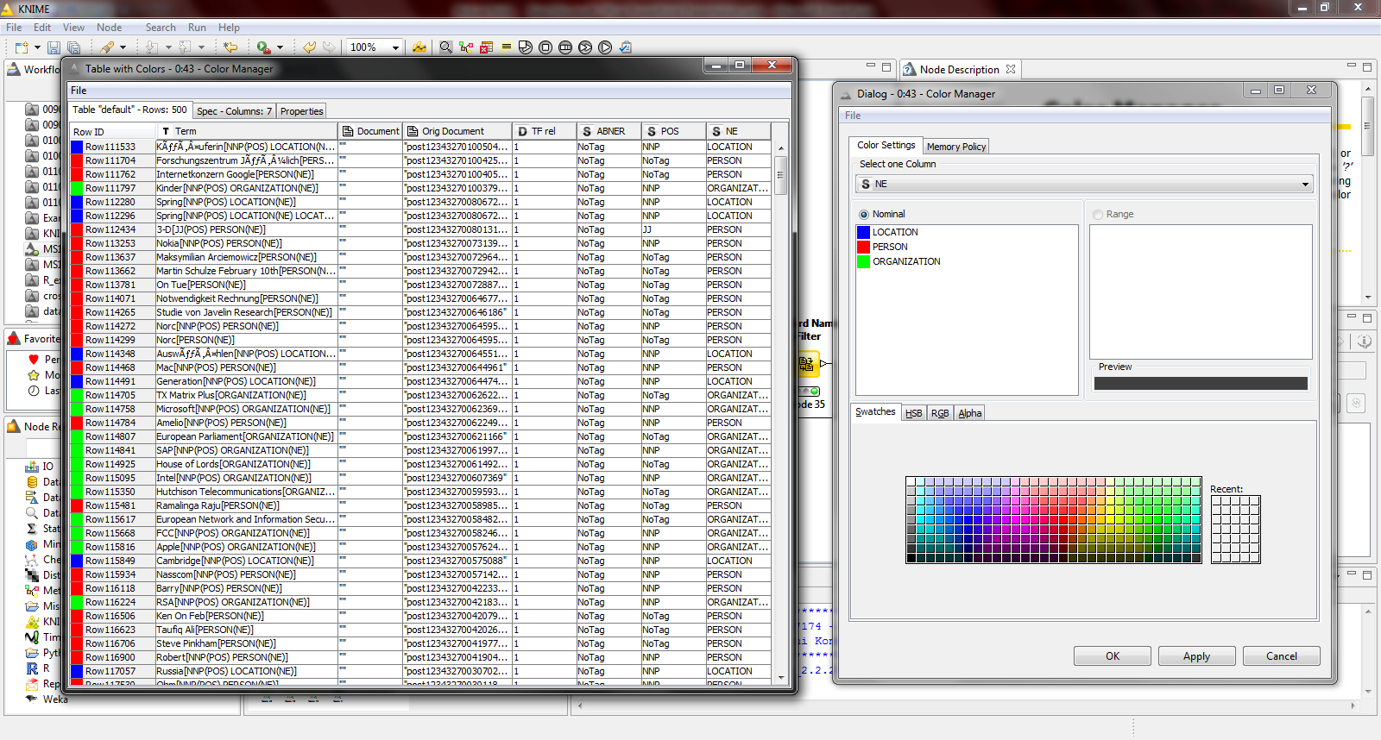
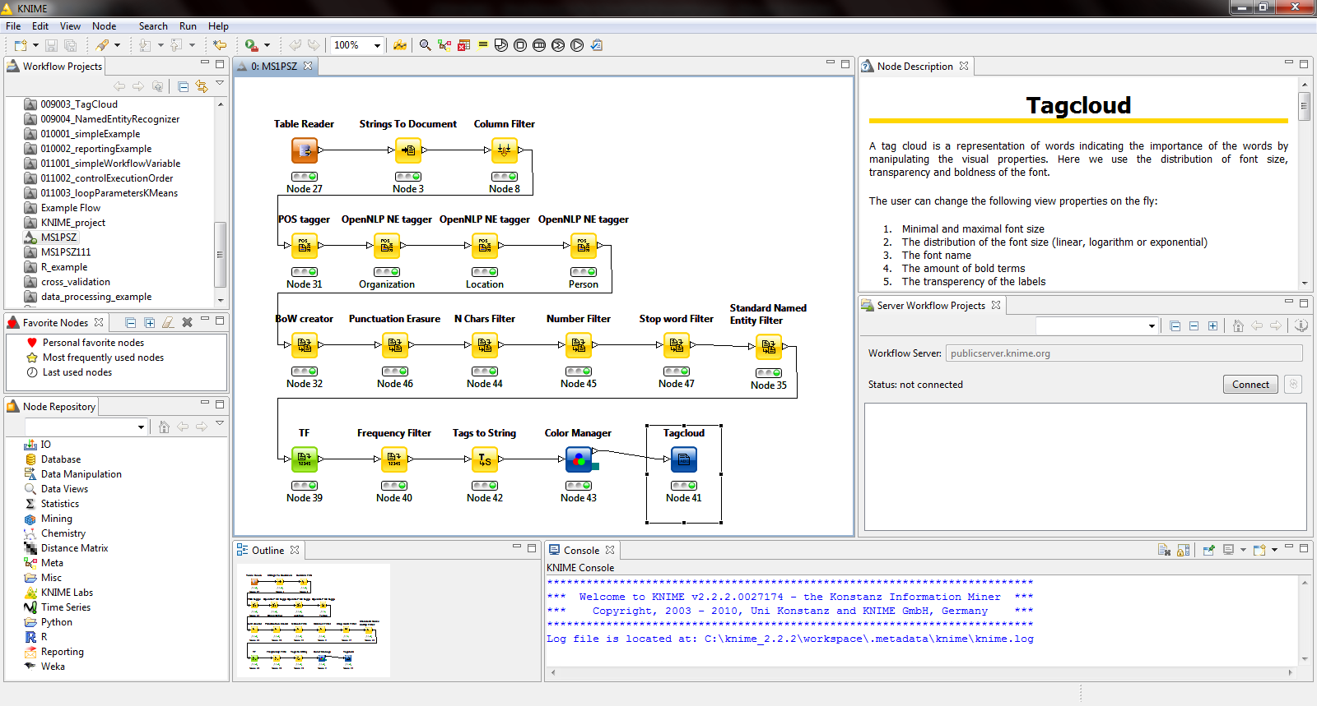
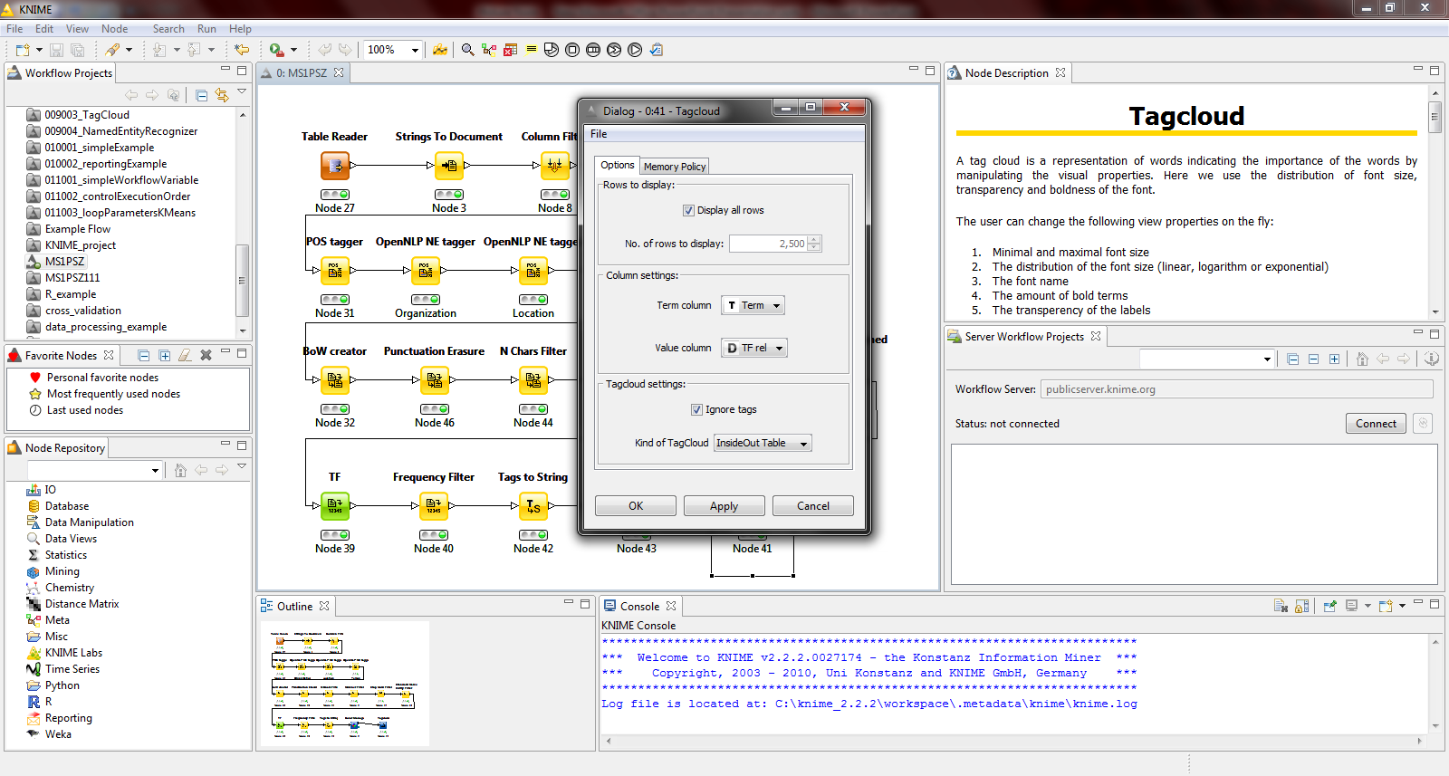
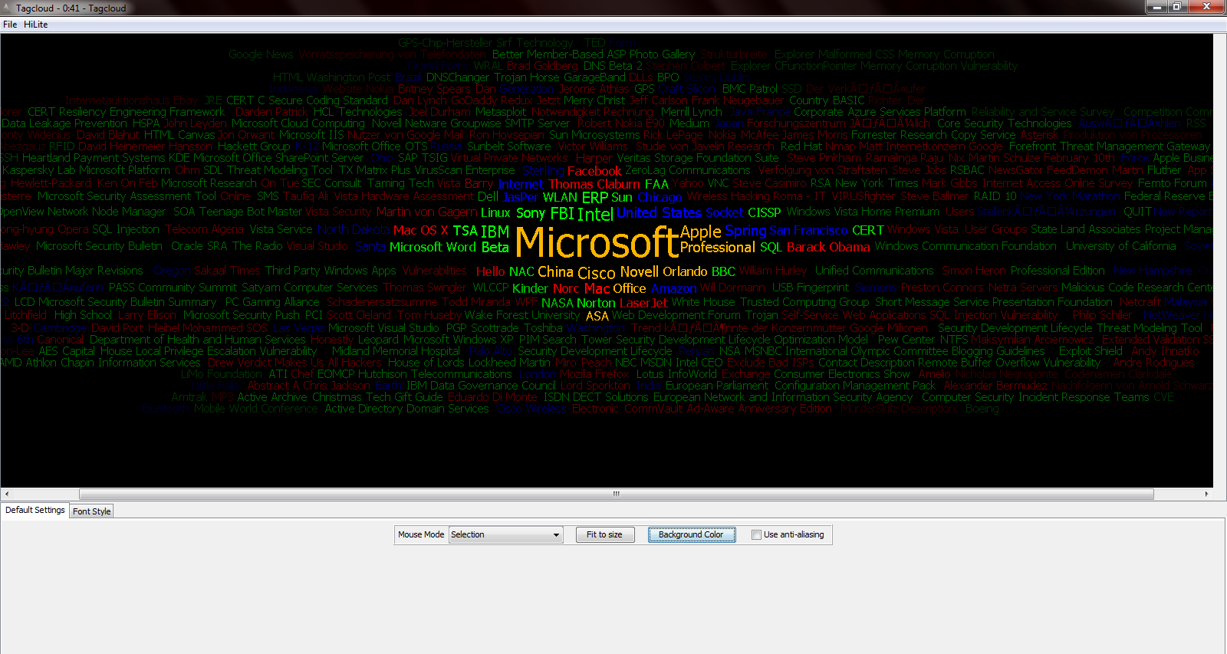
Example

Slide 19
Conclusion
Data mining is not an automated process
Data mining needs appropriate SW tools
Frequently more than one SW
Knime is an effective solution for educational purposes
Lot of space for improvements in:
Supporting various data sources
Providing high performance data mining
Providing more domain-specific techniques
Better support for business application
Notes:
Data mining is not automated process, no matter how effective DM software is
We present the four following important points for open source data mining
systems to gain greater success in deployment:
1. Supporting various data sources
A good open source data mining system should support most commonly
used data sources, such as the open source and commercial databases, csv
files, and user defined formats.
2. Providing high performance data mining
Most open source data mining systems can’t operate on large volumes of
data. To offer high performance data mining we need to either rewrite the
algorithms (e.g. parallel and distributed algorithms) or more simply to improve
the hardware on which the software is running.
3. Proving more domain-specific techniques
Most data mining systems integrate many algorithms at the whim of the
researchers, rather than for the benefit of business.We need to better identify
algorithms that match the data to be processed. One approach will be to
provide domain-specific techniques based on a generic platform.
4. Better support for business application
Real business application are complex, placing many demands on the data
mining system. Open source data mining systems need to in improve scalability,
reliability, recoverability, and security [33].

Slide 20
Q & A
Do you have any questions?
Stefan Jakšić - jaksamoowe@gmail.com
Nenad Ivanović - nenadpeuau@gmail.com

Slide 21
References
[1] Daniel T. Larose , “Discovering Knowledge In Data - An Introduction to Data Mining”, Wiley-Interscience, Hoboken, New Jersey,2005.
[2] www.knime.org
[3] Xiaojun Chen, Yunming Ye, Graham Williams and Xiaofei Xu, “A Survey of Open Source Data Mining Systems” ,Shenzhen Graduate School, Shenzhen 518055, China, Harbin Institute of Technology, Australian Taxation Office, Australia,2007.
[4] www.wikipedia.org
[5] Ela Hunt, “Workflow management: motivation and vision“, The Swiss Initiative in Systems Biology,2010
[6] RapidMiner 5.0 User Manual

